Slide 1
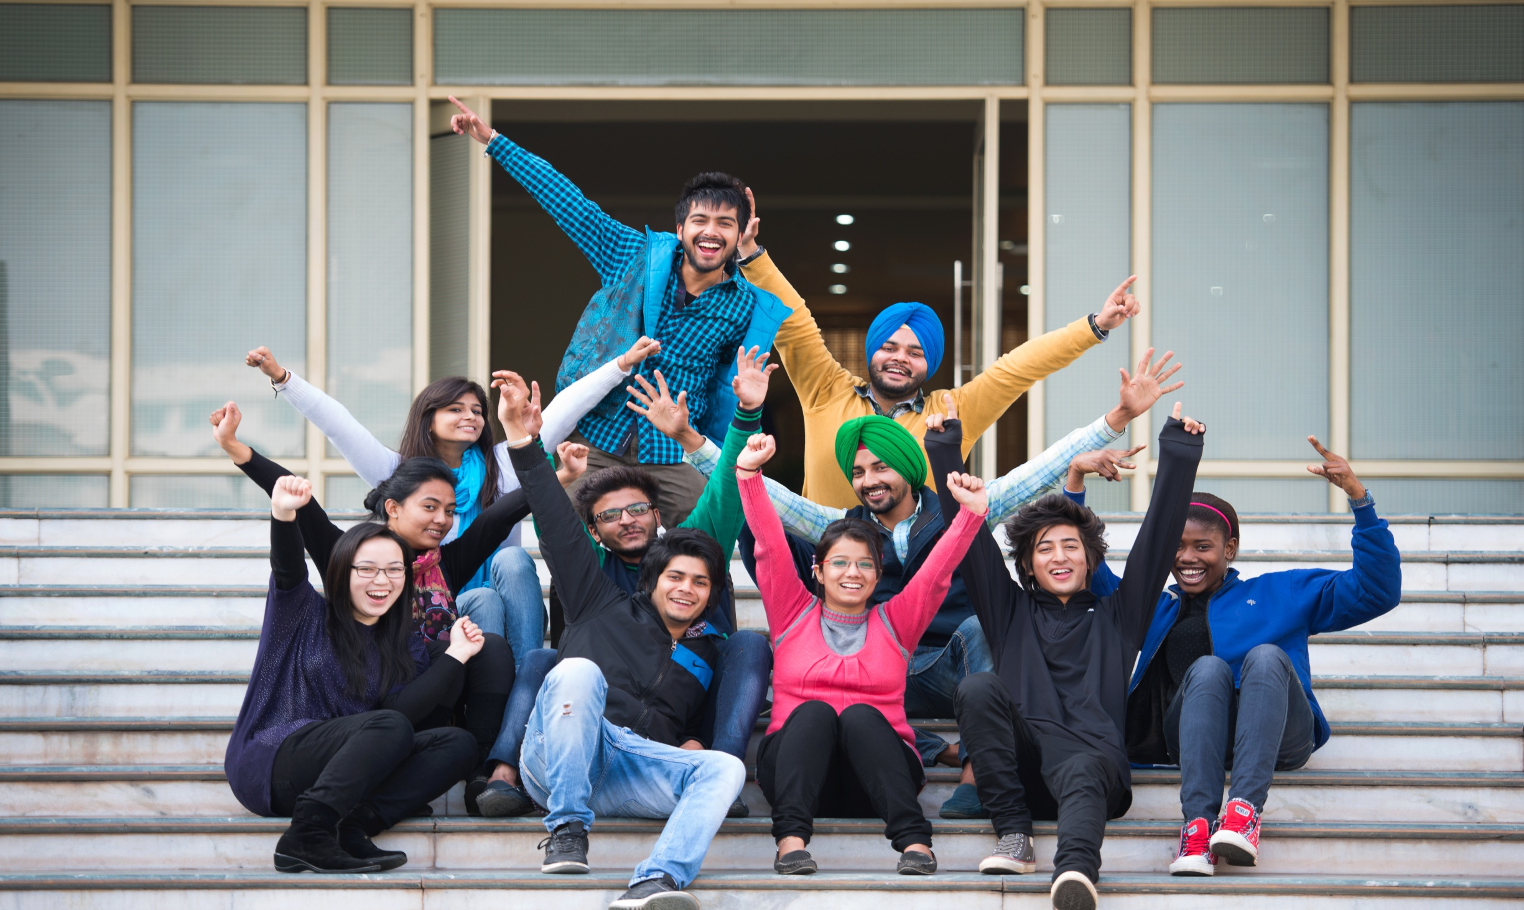


Extends Heartiest Greetings
to
Esteemed Dignitaries
www.cuchd.in
Campus: Gharuan, Mohali

Slide 2

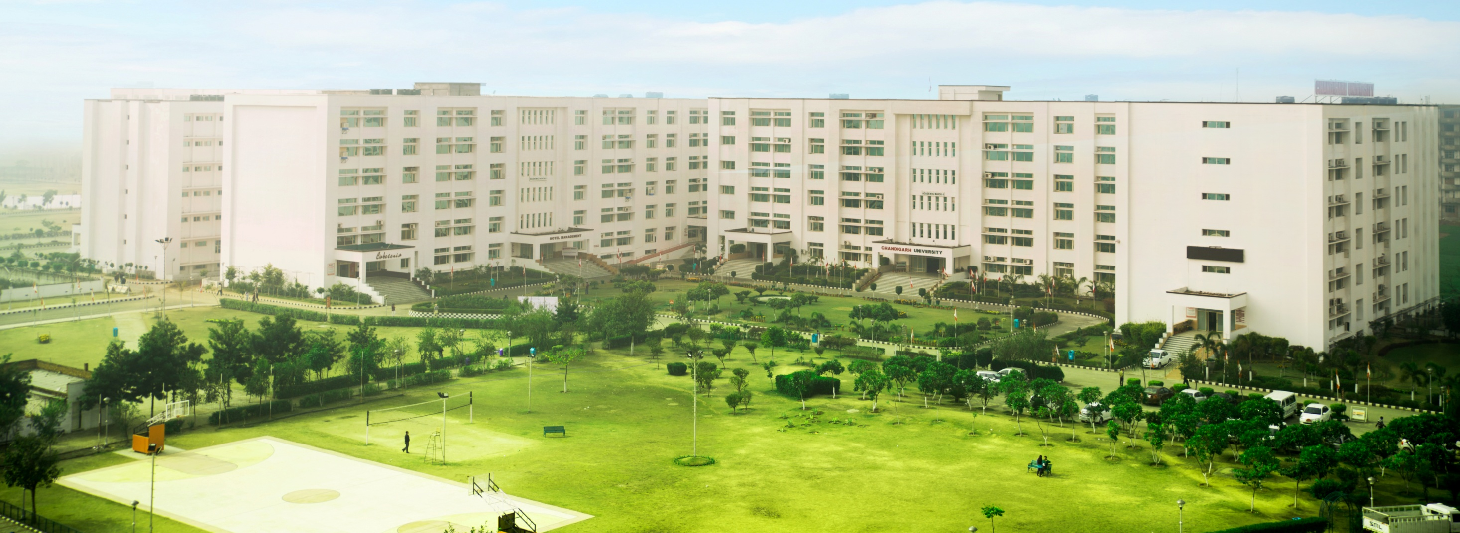
ESTABLISHMENT & APPROVALS
ESTABLISHMENT & APPROVALS
Rich Legacy of 14 years in Professional Education
University Grants Commission (UGC)
All India Council for Technical Education (AICTE)
Council of Architecture (CoA)
Pharmacy Council of India (PCI)
Association of Indian Universities (AIU)
International Association of Universities (IAU)
Indo US Collaboration for Engineering Education (IUCEE)
IEEE
Accredited by large number of prestigious Corporate houses
www.cuchd.in
Campus: Gharuan, Mohali

Slide 3

VISION
VISION
VISION
“To be globally recognized as a Centre of Excellence for Research, Innovation and state-of-the-art infrastructure for creating and disseminating knowledge by providing a unique platform for learning that will best serve the society at large”.
www.cuchd.in
Campus: Gharuan, Mohali

Slide 4
MISSION
To engage students as learners and develop them as Leaders in an intellectually challenging and contemporarily diverse environment.
To provide world class infrastructure and renowned academicians for ensuring an ideal environment for Research, Innovation and Consultancy.
To create a globally acceptable Course Curriculum along with comprehensive training to match industry needs.
To ensure a Transparent, Efficient and Impartial Examination/Evaluation system.
To establish strategic tie-ups with leading corporate & International institutions for academic and research collaborations.
To undertake socially relevant activities and research as a part of Institutional Social Responsibility (ISR).
www.cuchd.in
Campus: Gharuan, Mohali

Slide 5
QUALITY POLICY
We, at Chandigarh University are committed to inculcate the traits of Critical Analysis, Creative Thinking and Communication Skills for developing a high quality, well groomed professional manpower, possessing multifaceted personality, respect for professional & social ethics, national values and the spirit of human emancipation.
All round quality is assured through student centric policies, along with regular revision of curriculum, teaching learning model and experiential learning with Industry participation, based on continuous critical self-appraisal.
We are also committed to the welfare and professional growth of our employees by providing strong support and opportunities for their self-development, promoting commitment and willing participation.
www.cuchd.in
Campus: Gharuan, Mohali

Slide 6
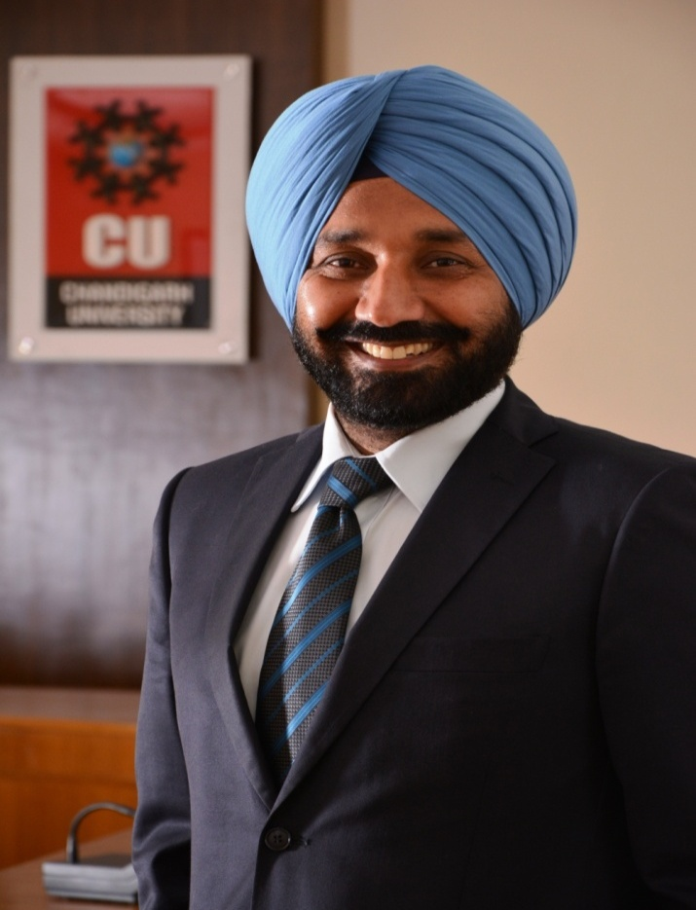
CHANCELLOR
Founder Chairman Chandigarh Group of Colleges (CGC) started in year 2001.
Honored with International Leadership Award in the field of education by Rome University
Decorated with top Edupreneur of the country award Presented by Sh. Shashi Tharoor, Minster of State, MHRD ,for transforming Engineering Education in India (Engineering Watch India)
Honoured with WCRC Leaders Edupreneur of the year 2012-13 by KPMG as Chancellor of one of Asia’s 100 best & fastest growing Private Educational Institutions.
India Today awarded ”Business Wizard Award 2014” in Professional Education.
S. Satnam Singh Sandhu
www.cuchd.in
Campus: Gharuan, Mohali

Slide 7


RANKING & AWARDS
RANKING & AWARDS
“Asia’s Fastest Growing Private Education Institutes”
“Outstanding Engineering Institute (North)”
www.cuchd.in
Campus: Gharuan, Mohali

Slide 8

RANKING & AWARDS
University Institute of Engineering , conferred with Outstanding Engineering Institute (North) Award, by ET NOW
University Institute of Engineering , conferred with Outstanding Engineering Institute (North) Award, by Dainik Bhaskar
Edupreneurs awards by discovery Education media
University Business School , conferred with Outstanding B School (North) Award, by Dainik Bhaskar
Chandigarh Business School conferred with B-School Innovation Award in Indian B-School Awards by Discovery Education Media
University School of Business , conferred with B School Leadership Award, by ET NOW
UIHM Awarded Best Hotel Management Institute for 2013 & 2014 by Indian Restaurant Award 2013 & 2014
www.cuchd.in
Campus: Gharuan, Mohali

Slide 9
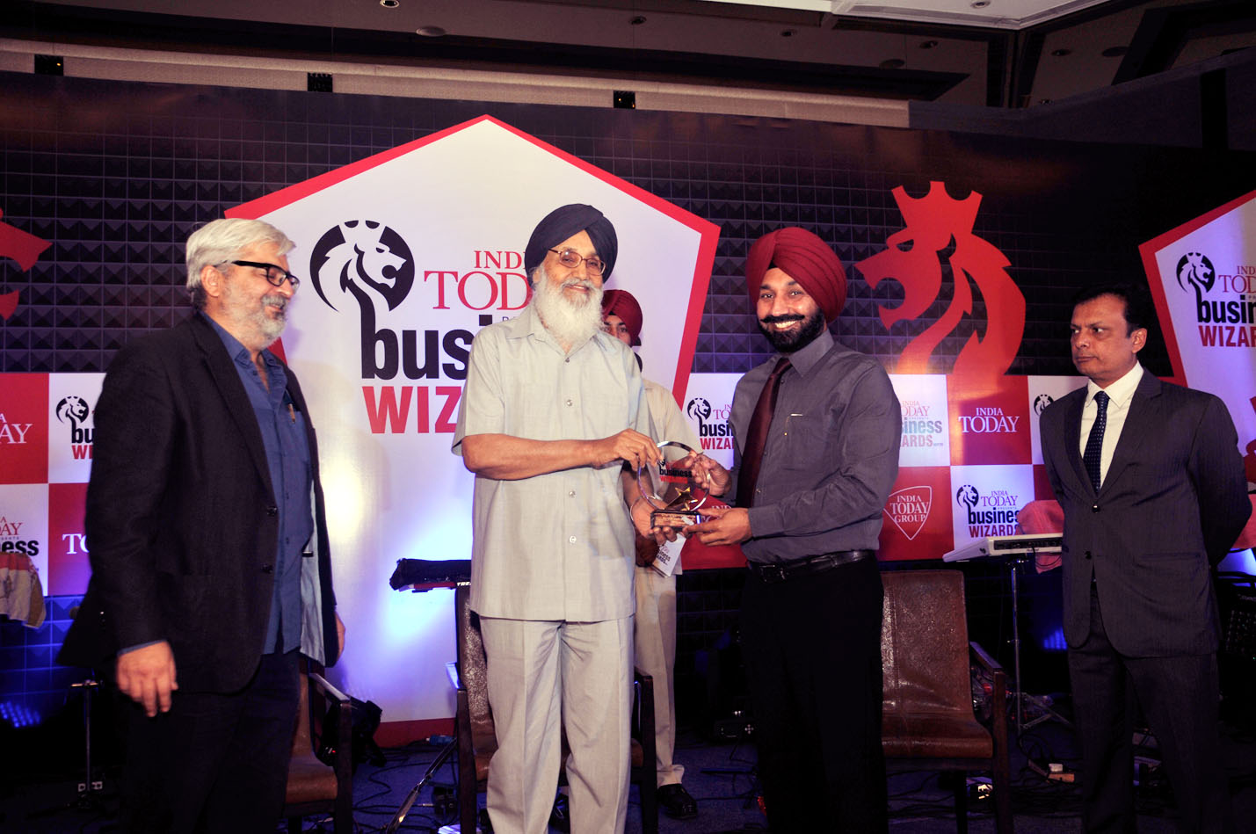
RANKING & AWARDS
INDIA TODAY’S AWARD 2014
Honorable Chief Minister, Punjab
S. Prakash Singh Badal
Honoring S. Satnam Singh Sandhu Chancellor, Chandigarh University with India Today Wizard of North India award in Professional Education.
www.cuchd.in
Campus: Gharuan, Mohali

Slide 10
WHAT MAKES CU AHEAD OF OTHERS
Advanced and extraordinary
Curriculum and teaching learning process
Faculty and infrastructure
International Collaborations
Research innovations and projects
Academic systems and discipline
Industry academic partnership
www.cuchd.in
Campus: Gharuan, Mohali

Slide 11
INSTITUTES OF UNIVERSITY
University Institute of Engineering (UIE)
University School of Business (USB)
University Institute of Hotel Management (UIHM)
University Institute of Computing (UIC)
University Institute of Bio & Pharma Sciences (UIPS)
University Institute of Architecture, Design & Planning (UIADP)
University Institute of Animation & Multimedia (UIAM)
University Institute of Legal Studies
University Institute of Agricultural Sciences
University Institute of Teacher’s Training & Research (UITTR)
www.cuchd.in
Campus: Gharuan, Mohali

Slide 12
UNIVERSITY INSTITUTE OF ENGINEERING (UIE)
Bachelor of Engineering (B.E.)
Course | Duration
Computer Science & Engineering (CSE) | 4 Years
Mechanical Engineering (ME) | 4 Years
Electronics and communication Engineering (ECE) | 4 Years
Electrical and Electronics Engineering (EEE) | 4 Years
Civil Engineering (CE) | 4 Years
Computer and Communication Engineering (CCE) | 4 Years
Electrical Engineering (EE) | 4 Years
Automobile Engineering (AME) | 4 Years
Chemical Engineering (CHE) | 4 Years
Petroleum Engineering (PE) | 4 Years
Mechatronics | 4 Years
Aero Space Engineering | 4 Years
Information Technology | 4 Years
www.cuchd.in
Campus: Gharuan, Mohali

Slide 13
UNIVERSITY INSTITUTE OF ENGINEERING (UIE)
Master of Engineering (M.E.)
Course | Duration
Computer Science & Engineering (CSE) | 2 Years
Electronics and communication Engineering (ECE) | 2 Years
Electrical Engineering (EE) | 2 Years
Information Technology (IT) | 2 Years
Mechanical Engineering (ME) | 2 Years
Civil Engineering (CE) | 2 Years
www.cuchd.in
Campus: Gharuan, Mohali

Slide 14
UNIVERSITY SCHOOL OF BUSINESS (USB)
Under Graduate Courses
Course | Duration
Bachelor of Business Administration (BBA) | 3 Years
Bachelor of Commerce (B.Com) Honors | 3 Years
Post Graduate Courses
Course | Duration
MBA (Marketing/HR/Finance /IT/IB) | 2 Years
MBA (Tourism & Hospitality Management) | 2 Years
MBA-Agri. Business | 2 Years
M Com ( Honors) | 2 Years
www.cuchd.in
Campus: Gharuan, Mohali

Slide 15
IBM COLLABORATION COURSES
Bachelor of Engineering (Hons.) in Computer Science Engineering
Course | Duration
BE CSE (Hons.) in Cloud Computing | 4 Years
BE CSE (Hons.) in Big Data and Analytics | 4 Years
BE CSE (Hons.) in Information Security | 4 Years
Masters of Business Administration
Course | Duration
MBA in Business Analytics | 2 Years
www.cuchd.in
Campus: Gharuan, Mohali

Slide 16
UNIVERSITY INSTITUTE OF COMPUTING (UIC)
Under Graduate Course
Course | Duration
Bachelors in Computer Applications (BCA) | 3 Years
B. Sc Computer Science | 3 Years
Post Graduate Course
Course | Duration
Masters in Computer Applications (MCA) | 3 Years
www.cuchd.in
Campus: Gharuan, Mohali

Slide 17
UNIVERSITY INSTITUTE OF ARCHITECTURE (UIA)
Under Graduate Courses
Courses | Duration
Bachelors in Architecture (B. Arch) | 5 Years
Bachelors in Design (Interior Design) | 4 Years
www.cuchd.in
Campus: Gharuan, Mohali

Slide 18
UNIVERSITY INSTITUTE OF HOTEL MANAGEMENT (UIHM)
Under Graduate Courses
Course | Duration
B Sc Hotel Management & Catering Technology (HMCT) | 3 Years
B Sc Airline Tourism & Hospitality Management (ATHM) | 3 Years
Post Graduate Course
Course | Duration
M Sc Hotel Management | 2 Years
www.cuchd.in
Campus: Gharuan, Mohali

Slide 19
UNIVERSITY INSTITUTE OF ANIMATION & MULTIMEDIA TECHNOLOGY (UIAM)
Under Graduate Course
Course | Duration
B Sc Animation & Multimedia Technology (A & MT) | 3 Years
Post Graduate Course
Course | Duration
M Sc Animation & Multimedia Technology (A & MT) | 2 Years
www.cuchd.in
Campus: Gharuan, Mohali

Slide 20
UNIVERSITY INSTITUTE OF BIO & PHARMA SCIENCES (UIPS)
Under Graduate Courses
Course | Duration
B.Sc Biotechnology | 3 Years
B. Pharmacy | 4 Years
B.Sc Medical Lab Technology (MLT) | 3 Year
Post Graduate Course
Course | Duration
M.Sc Biotechnology | 2 Years
M.Sc Forensic Science and Toxicology | 2 Years
www.cuchd.in
Campus: Gharuan, Mohali

Slide 21
UNIVERSITY INSTITUTE OF LEGAL STUDIES
Under Graduate Courses
Course | Duration
Bachelor of Laws | 3 Years
Bachelor of Laws | 5 Years
www.cuchd.in
Campus: Gharuan, Mohali

Slide 22
UNIVERSITY INSTITUTE OF AGRICULTURAL SCIENCES
Under Graduate Courses
Course | Duration
B Sc Agri.+ MBA Agri. Business (Integrated) | 5 Years
B Sc Agriculture | 4 Years
www.cuchd.in
Campus: Gharuan, Mohali

Slide 23
UNIVERSITY INSTITUTE OF TEACHERS TRAINING & RESEARCH (UITTR)
Master of Engineering (Honors)
Course | Duration
Electronics and communication Engineering (ECE) | 2 Years
Computer Science & Engineering (CSE) | 2 Years
Mechanical Engineering (ME) | 2 Years
Electrical Engineering (EE) | 2 Years
Civil Engineering (CE) | 2 Years
(University Sponsored Program)
www.cuchd.in
Campus: Gharuan, Mohali

Slide 24
DOCTORAL PROGRAMS
DOCTORAL PROGRAMS
Sr. No. | Discipline
1. | Electronics and communication Engineering (ECE)
2. | Computer Science & Engineering (CSE)
3. | Mechanical Engineering (ME)
4. | Business Management
5. | Mathematics
6. | Physics
7. | Chemistry
The University offers a fellowship of Rs 21,600 to its full time PhD scholars
The candidates for PhD are required to select a research problem which has direct Industrial or Business application with a potential for patent or new product.
Only 38 seats offered for PhD programmes and after rigorous admission process based on UGC guidelines only 15 student selected in 02 tests
www.cuchd.in
Campus: Gharuan, Mohali

Slide 25
INNOVATIVE SCHEME FOR CREATING DEDICATED & TRAINED TEACHERS
There is a need for creating dedicated and trained teachers in all disciplines of professional education. The university is already offering ME (Hons) courses in some disciplines of engineering where in courses on teaching learning & teaching pedagogy are being taught.
To promote the culture of becoming a teacher and to motivate young and meritorious professionals to choose teaching as a career, the following steps are proposed to be taken.
Open elective courses in education (B.Ed level) for all Engineering courses.
Two courses i.e Education Psychology & Education Technology as compulsory/elective component for all Masters level courses.
The same two courses i.e Education Psychology & Education Technology as open elective for MBA programmes.
www.cuchd.in
Campus: Gharuan, Mohali

Slide 26
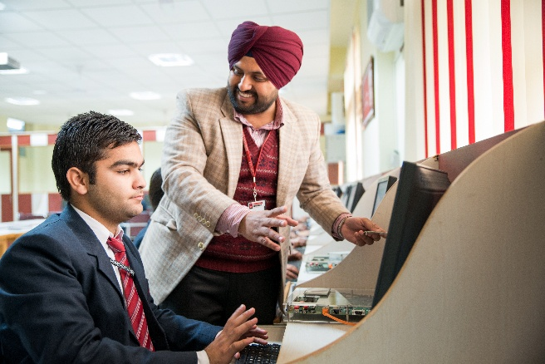
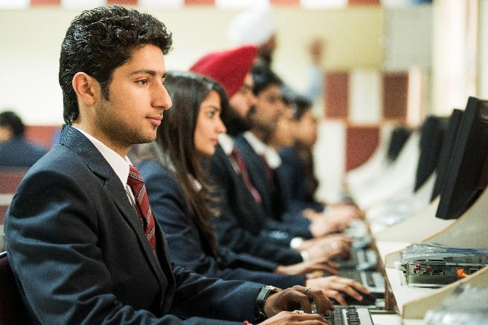
IT INFRASTRUCTURE
More than 4000 computers with latest configurations
Wi-Fi enabled campus more than 200 Access Points powered by Ruckus and Cisco
310 Mbps Bandwidth
Latest Software Cognos, Matlab, Oracle, Eclipse, Blue- J,NS3, RSA, IMS, Weka, SPSS, 3-D Max, Sound Forge, Auto – CAD etc.
High end servers from IBM,HP and Cisco
www.cuchd.in
Campus: Gharuan, Mohali

Slide 27

ACADEMIC EXCELLENCE
Academic excellence is the key to all professional achievements.
CU provides excellent curriculum, faculty, infrastructure, teaching learning process, continuous internal assessment system, transparent & universally accepted grading system of examination and conducive academic atmosphere leading to Academic Quality Assurance
www.cuchd.in
Campus: Gharuan, Mohali

Slide 28
FACULTY STRENGTH
The University has presently 105 doctorates.
More than 200 faculty members pursuing Ph.D.
Faculties from reputed institutions like IIT’s, NIT’s and reputed universities.
Faculty has more than 2000 publications to their credit. and are encouraged to do research, participate in seminars, attend conferences.
Professors 78
Associate Professor 162
Assistant Professor 518
758
www.cuchd.in
Campus: Gharuan, Mohali

Slide 29
UNIQUE CURRICULUM DEVELOPMENT
CURRICULUM DEVELOPMENT
ACCAREDATION BODIES ABET, NBA
IMPORTANT UNIVERSITIES MIT, STANFORD, IITs ETC
PROFESSIONAL BODIES ASME, IEEE, FICCI
GLOBAL PROJECTIONS ILO
CORPORATES
www.cuchd.in
Campus: Gharuan, Mohali

Slide 30
UNIQUE CURRICULUM DEVELOPMENT METHODOLOGY
Input for revision
Students Feedback
Faculty Feedback
External Industrial Experts
External Academic Experts
Reports of Professional Bodies
Placement Team
Important Universities
New scheme
Brain storming
BOS
Faculties
Academic Council
Stage I
Stage II
www.cuchd.in
Campus: Gharuan, Mohali

Slide 31
SCHEME DEVELOPMENT METHODOLOGY
Implementation
Training for new scheme and system
Development of Specialization Groups
Training for interdisciplinary courses
Organizing modular courses for teachers
From
Stage II
Evaluation
Rectification
Stage III
www.cuchd.in
Campus: Gharuan, Mohali

Slide 32
SIGNIFICANCE OF OUR SCHEME
Flexibility
Increased Academic input
Required Interdisciplinary concept
Strengthen the experiential learning
Placement oriented professional development
Space to adjust special industrial requirement
www.cuchd.in
Campus: Gharuan, Mohali

Slide 33
BASIC IMPORTANT INPUTS
Future projections of professional Bodies
( ASME, IEEE, NSDC, FICCI, etc.)
Latest Detailed curriculum
(AICTE ,IIT New Delhi, Mumbai, MIT, SRM and VIT etc)
Global Employment Projections
( ILO ASME,NSDC)
PEO and PO by faculty
www.cuchd.in
Campus: Gharuan, Mohali

Slide 34
BOTTOM UP APPROACH
Program Educational Objectives (PEO)
Student /program Outcome (PO)
Scheme
Course outcomes (Syllabus)
Basic Projections and Expectations
www.cuchd.in
Campus: Gharuan, Mohali

Slide 35
FLEXIBILITY TO ADJUST SPECIAL INDUSTRIAL REQUIREMENTS
Can select
A sub discipline of his choice
subjects in sub-discipline
open electives
5 Projects at different levels
Replaced with special industrial requirements 25%
www.cuchd.in
Campus: Gharuan, Mohali

Slide 36
PLACEMENT ORIENTED PROFESSIONAL DEVELOPMENT
Soft skills
Additional Optional Input After 4th semester
Humanities
Economics 3 credits
Law (3 credits )
Technical skills
Engineering Practice 05 credits
Professional Competence For MBA
Aptitude 6 Credits
Biology
Professional ethics
www.cuchd.in
Campus: Gharuan, Mohali

Slide 37
Semester Academic Process (Learning Control Systems)
Feed back
As a tool for quality enhancement
Informal
Academic Audit
By Internal Team
By External Experts
Formal
Academic Observation
Regular conduct and contents Delivery Monitored
www.cuchd.in
Campus: Gharuan, Mohali

Slide 38
Semester Academic Process (Learning Control Systems)
Online
Structured Feed Back
Website
Offline
Regular CR meetings
Offline
Direct applications or suggestions
Suggestion Boxes
Student Care centers
Emails
www.cuchd.in
Campus: Gharuan, Mohali

Slide 39

EXAMINATION SYSTEM
Choice Based Credit System formulated by the UGC is almost same as being used in CU since 2012.
External Paper Setting & Internal Evaluation
Evaluation is done question wise to ensure uniformity
10% answer sheets re-evaluated by external experts
Practical's and Project work evaluated by external experts
Transparency –Answer sheets are shown to the students
Globally acceptable Relative Grading based CGPA system
Three marks are deducted for a mass bunk for the whole class
www.cuchd.in
Campus: Gharuan, Mohali

Slide 40
EVALUATION SYSTEM
(THEORY)
S. No. | Element | Marks
1 | First Hourly Test | 6
2 | Mid Term Test | 12
3 | Second Hourly Test | 6
4 | Surprise Test | 3
5 | Quiz | 3
6 | Assignment/ Case Studies | 4
7 | Tutorial/ Short Report | 4
8 | Excellent Attendance >90% | 2
9 | End Semester Examination | 60
 | TOTAL | 100
www.cuchd.in
Campus: Gharuan, Mohali

Slide 41

INTERNAL ASSESSMENT SYSTEM
(PRACTICAL)
Internal Assessment- 60%
Each practical is evaluated individually out of 30 marks as follows:
12 marks for doing/attending the practical
8 marks for viva-voce of that practical
10 marks for practical record/note book
Total marks obtained by a student in a semester are added and reduced out of 45
15 marks are allotted to internal practical tests to be held twice during the semester
www.cuchd.in
Campus: Gharuan, Mohali

Slide 42
GRADE POINT SYSTEM
Grade in letters | Performance | Grade Point
O | Outstanding | 10
A | Excellent | 9
B⁺ | Very Good | 8
B | Good | 7
C⁺ | Average | 6
C | Below Average | 5
P | Marginal/Pass | 4
E | Exposed/Absent | 0
F | Poor/Fail | 0
I | Incomplete/Detained | 0
www.cuchd.in
Campus: Gharuan, Mohali

Slide 43
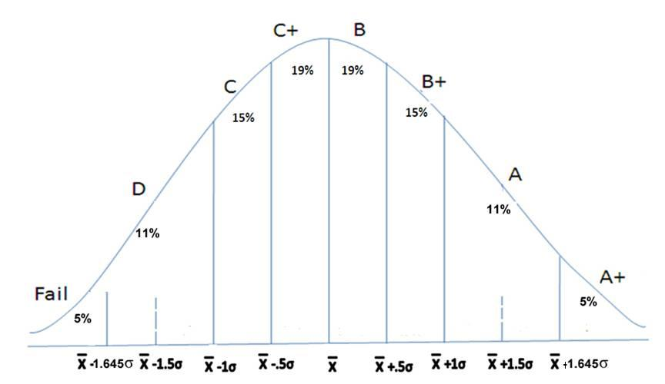
AWARDING OF GRADES
P
O
www.cuchd.in
Campus: Gharuan, Mohali

Slide 44
PROMOTION TO NEXT YEAR
Grading is done through a software without any manual intervention & subjectivity subject to the conditions :
A student getting 50% or more than the highest scored marks shall not get ‘F’ grade i.e. She/he will get at least ‘P’ grade.
A student getting less than 35% of the highest scored marks shall get ‘F’ grade
For promotion from 1st year to 2nd year Student should have:
Minimum grade point 3.50 for UG & 4.00 for PG or earned at least 40% of the credits offered
For promotion to 3rd year the minimum CGPA required is 4.00 or earning 40% of credits offered during Ist and IInd year for UG.
For award of degree minimum CGPA required is 4.50 for UG & 5.00 for PG.
www.cuchd.in
Campus: Gharuan, Mohali

Slide 45
UNIVERSITY CENTRE FOR RESEARCH & DEVELOPMENT
Chandigarh University (CU) is envisioned to be the fountainhead of new ideas, innovation in technology and science and with its general goal to create an ambience in which new ideas, research and scholarship flourish from which the leaders and innovators of tomorrow emerge.
For promotion of research a provision of Rs. 35 Million have been made in the annual budget of the University.
To coordinate with industries, administer the policies related to research & consultancy services, and maintain the relevant documents, Chandigarh University has set up University Centre for Research & Development (UCRD).
www.cuchd.in
Campus: Gharuan, Mohali

Slide 46
UNIVERSITY CENTRE FOR RESEARCH & DEVELOPMENT
The University has established an Intellectual Property Right (IPR) Cell headed by Dean Research in 2014 and within 6 months of establishment; it was able to file 08 patents and 02 Trademarks. In the current year 03 Centre of Excellence (COE) are planned each for Department of Mechanical, Electronics & Communication and Computer Science & Engineering.
In addition to COE, all the departments of the University will also establish Centre of Research (COR) on the thrust areas. It is very gratifying that funding from Department of Science and Technology for various events has started.
Another new development for the University has been the formation of a partnership between the CU, International Universities and local research organizations.
www.cuchd.in
Campus: Gharuan, Mohali

Slide 47
UNIVERSITY CENTRE FOR RESEARCH & DEVELOPMENT
The various departments of university has publish around 493 research papers in the two years 2012-14.
PUBLICATIONS IN INTERNATIONAL & NATIONAL JOURNALS
www.cuchd.in
Campus: Gharuan, Mohali

Slide 48
UNIVERSITY CENTRE FOR RESEARCH & DEVELOPMENT
International Conferences
www.cuchd.in
Campus: Gharuan, Mohali

Slide 49
UNIVERSITY CENTRE FOR RESEARCH & DEVELOPMENT
National Conferences
www.cuchd.in
Campus: Gharuan, Mohali

Slide 50
UNIVERSITY CENTRE FOR RESEARCH & DEVELOPMENT
Books Publication
www.cuchd.in
Campus: Gharuan, Mohali

Slide 51
STUDENTS PROJECTS AND FUNDING
Project Funding
Publication Incentive
Funding for Participation in Competitions
Funding for Participation in Workshops/Conferences
www.cuchd.in
Campus: Gharuan, Mohali

Slide 52
STUDENTS PROJECTS AND FUNDING
University Innovation Day organized every year. It is a four stage competition based on ‘Idea to Enterprise’ Philosophy
University Tech-Invent event is organized every year by inviting global participants also. Every year a theme is given like SMART CAR is the theme for Tech-Invent 2015
A competition Entre-xcellence for promoting entrepreneurship among students is organized every year
To showcase and promote cultural prowess of the students CU-FEST is organized involving national level participants
www.cuchd.in
Campus: Gharuan, Mohali

Slide 53

INTERNATIONAL
Department of International Relations
The Department of International Relations has been established to stimulate curiosity for and love for learning globally, which widens the scope of educational opportunity and access for students.
Chandigarh University works closely with leading universities around the world
www.cuchd.in
Campus: Gharuan, Mohali

Slide 54



















INTERNATIONAL COLLABORATIONS
GCU, Scotland
UK
Canada
Germany
Switzerland
USA
France
Spain
Poland
Mongolia
Mexico
Thailand
Argentina
www.cuchd.in
Campus: Gharuan, Mohali

Slide 55

INTERNATIONAL PARTNER UNIVERSITIES
University of California, River Side
Schiller International University, USA
University of the District of Columbia, Washington DC , USA
The University of Mississippi, Oxford, USA
Youngstown State University, USA
www.cuchd.in
Campus: Gharuan, Mohali

Slide 56


INTERNATIONAL PARTNER UNIVERSITIES
Royal Roads University, Canada
Camosun College, Victoria, BC, Canada
Kings Western University, Canada
University of Regina, Saskatchewan, Canada
Birmingham City University, UK
University of Chester, UK
Northumbria University, UK
Middlesex University, UK
Glasgow Caledonian University, UK
Cardiff Metropolitan University, UK
www.cuchd.in
Campus: Gharuan, Mohali

Slide 57

INTERNATIONAL PARTNER UNIVERSITIES
EPITA, France
Schiller International University, France/ Germany
Rovira i Virgili University, Spain
Universitat Politecnica De Catalunya Spain
National University of Colombia
University of AL Mustansiriya – Iraq
National Polytechnic Institute, Mexico
Royal Academy International University, Mongolia
University of Lodz, Polland
Burapha University, Thailand
National University of Cuyo, Argentina
Soongsil University, South Korea
University of Business and International Studies, Switzerland
www.cuchd.in
Campus: Gharuan, Mohali

Slide 58




INTERNATIONAL COLLABORATIONS
International Association
of Universities
International Association of Students in Economic and Commercial Sciences
Six Capital Pte. Ltd. Singapore
Immer Qi, China
www.cuchd.in
Campus: Gharuan, Mohali

Slide 59
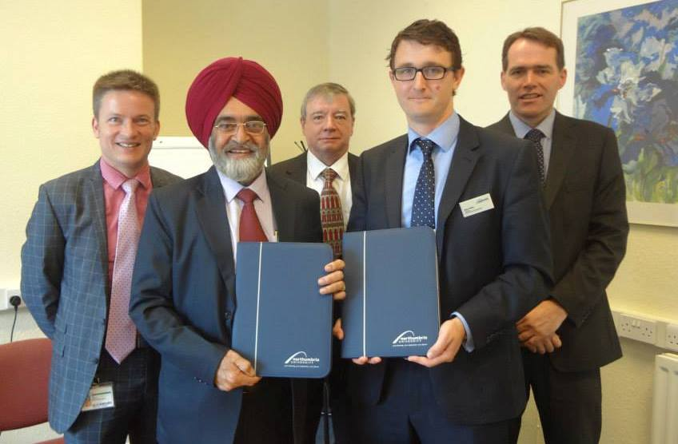
INTERNATIONAL COLLABORATIONS
Exchange of MOU with Northumbria University at Newcastle, UK
www.cuchd.in
Campus: Gharuan, Mohali

Slide 60
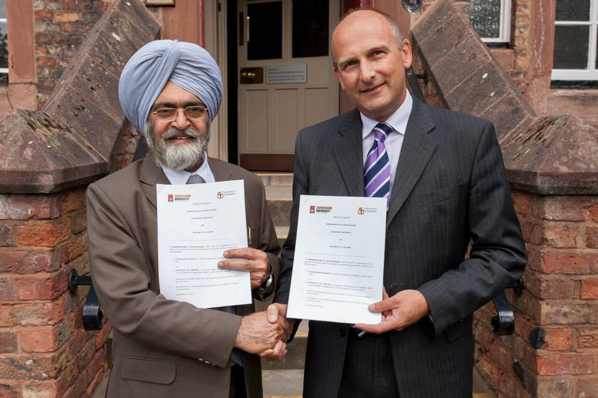
INTERNATIONAL COLLABORATIONS
Exchange of MOU with the University of Chester, UK
www.cuchd.in
Campus: Gharuan, Mohali

Slide 61
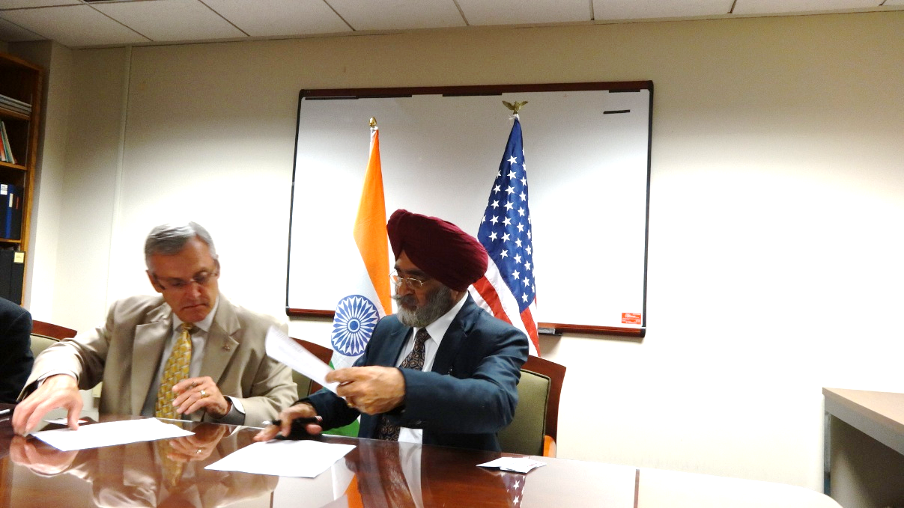
INTERNATIONAL COLLABORATIONS
Signing of MOU with Young’s Town State University, USA
www.cuchd.in
Campus: Gharuan, Mohali

Slide 62
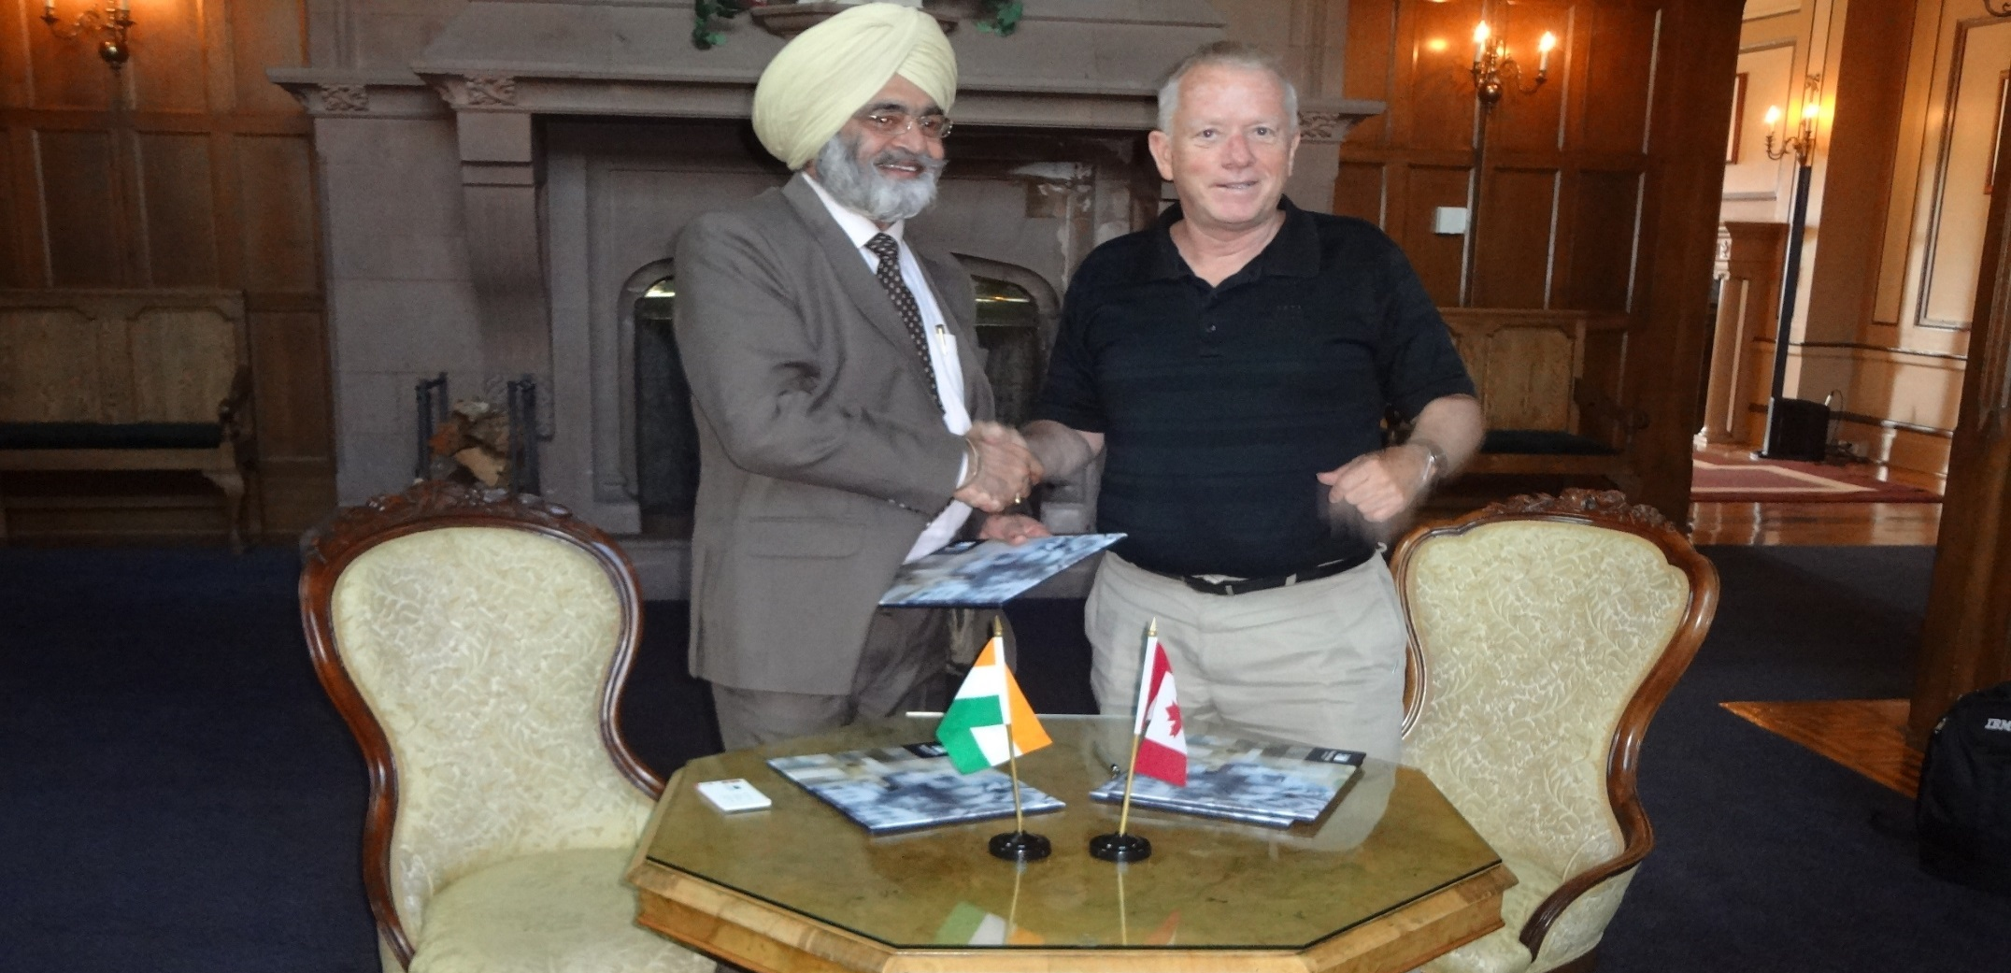
INTERNATIONAL COLLABORATIONS
Exchange of MOU with the Royal Roads University, Canada
www.cuchd.in
Campus: Gharuan, Mohali

Slide 63
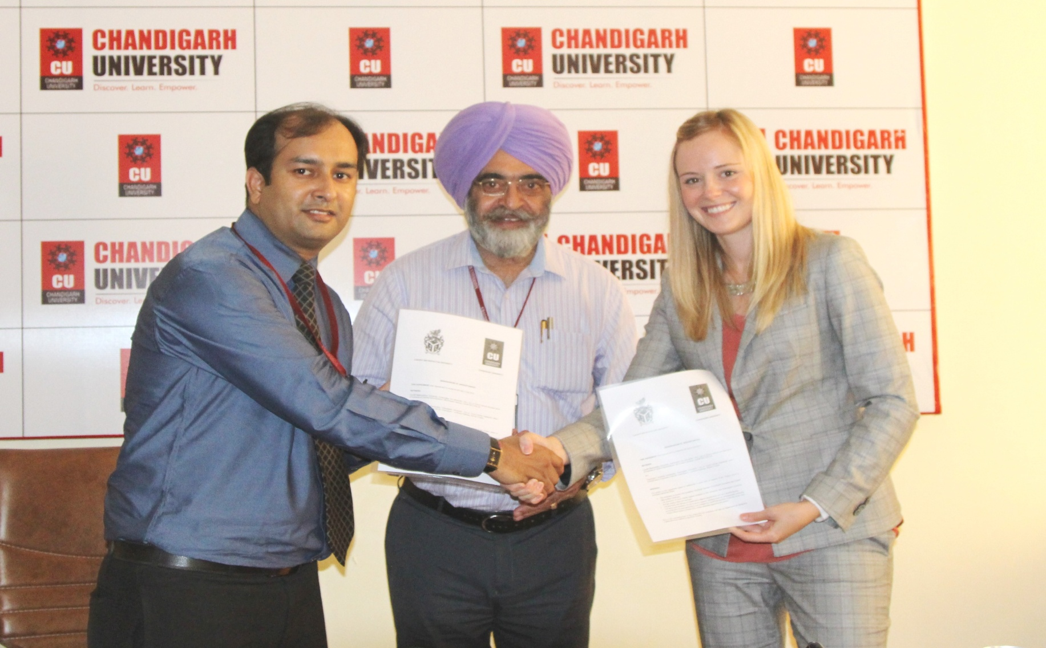
INTERNATIONAL COLLABORATIONS
Exchange of MOU with Cardiff Metropolitan University
www.cuchd.in
Campus: Gharuan, Mohali

Slide 64
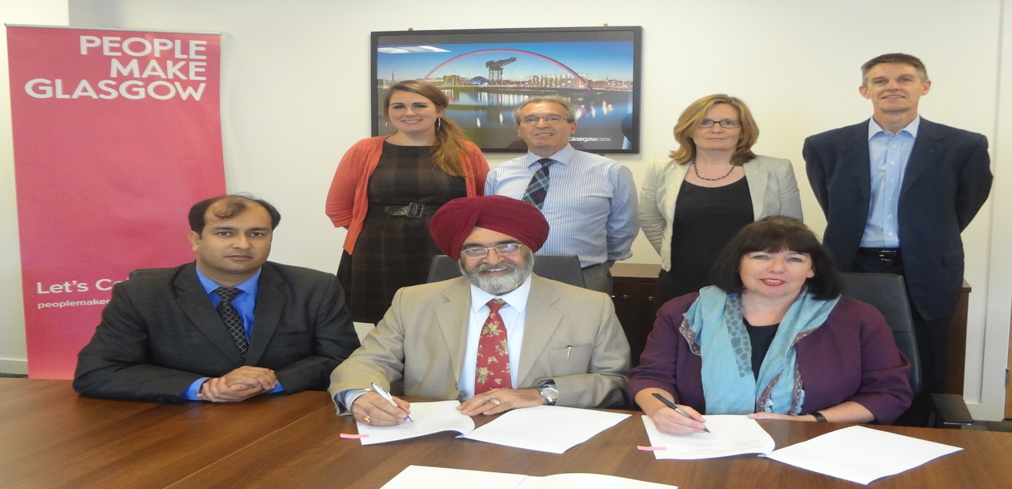
INTERNATIONAL COLLABORATIONS
Signing of MOU with Glasgow Caledonian University, UK
www.cuchd.in
Campus: Gharuan, Mohali

Slide 65
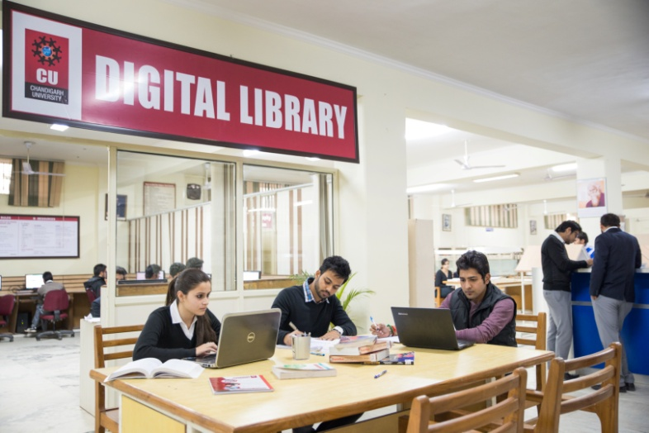
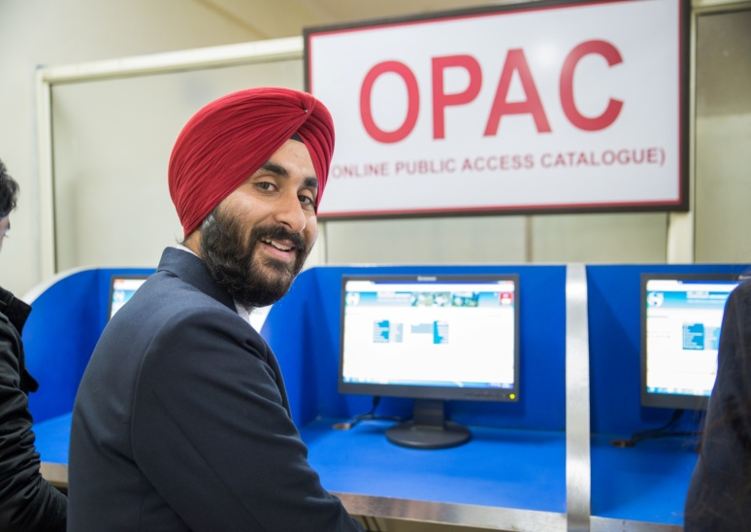
UNIVERSITY LIBRARY
Each Academic Block has an Independent Library
Databases: EBSCO, ASCE
Internet and E-mail
Multimedia Documents
ELSEVIER, J-Gate, Emerald,
ASME Springer, IEEE etc.
Electronic Journals
www.cuchd.in
Campus: Gharuan, Mohali

Slide 66
DIGITAL LIBRARY AND E-RESOURCES
http://www.cuchd.in/e-library/
PUBLISHER | URL ADDRESS | Qty
IEEE | http://ieeexplore.ieee.org | 145 Journals plus back file to 2000
McGRAW HILL’S ACCESS ENGINEERING | http://2.accessengineeringlibrary.com | 363 E-Books
ASTM DIGITAL LIBRARY | http://enterprise.astm.org/ | 47000 Articles from 9 Engineering Journals
J-GATE | http://www.jgateplus.com | 4700 Indexed, free full text 1700
ASME | http://asmedigitalcollection.asme.org/ | 26 Journals plus back file to 2000
ASCE | http://ascelibrary.org/journals/all-journals-titles | 34 Journals Plus Back file to 1983
ELSEVIER | http://www.sciencedirect.com/ | SCIENCE DIRECT 275 Journals (Back File Access from 2000 onwards)
Springer | http://www.link.springer.com/ | 586 Journals
Emerald | http://www.emeraldinsight.com/index.htm | 120 journals
EBSCO | http://search.ebscohost.com/ | 1081 E-Journals, Magazines and Trade Publications 2011
www.cuchd.in
Campus: Gharuan, Mohali

Slide 67
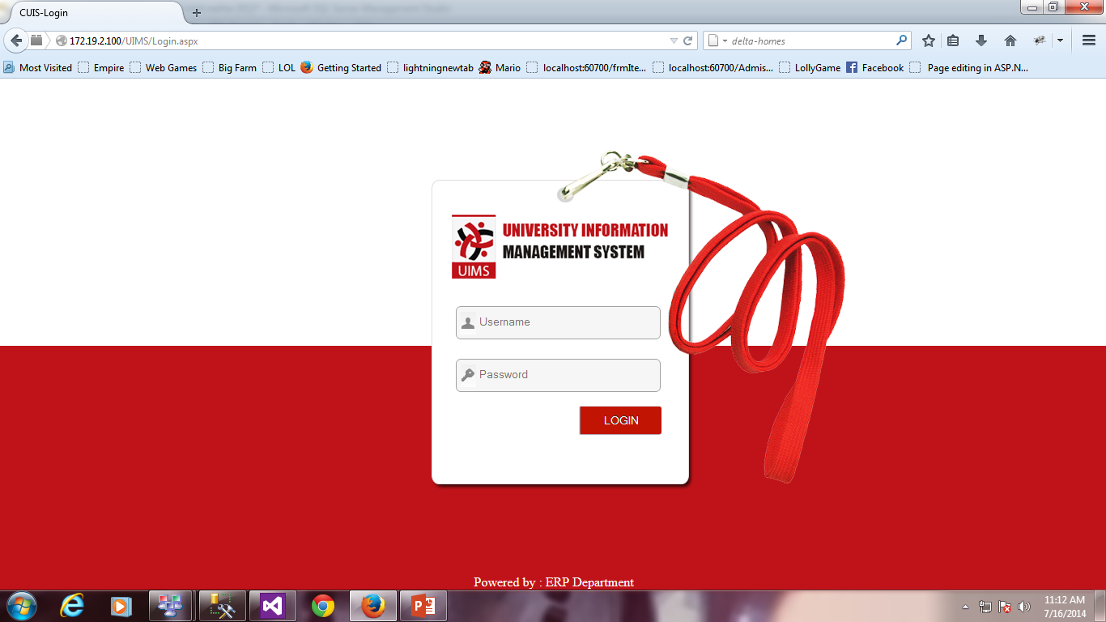
UNIVERSITY INFORMATION MANAGEMENT SYSTEM(Students)
PAPERLESS ACADEMIC SYSTEM
Online Notice Board
Daily Attendance
Resource Library
Online Assignment
Feedback
Result
Messages and Alerts
Library
http://172.19.2.100/UIMS/Login.aspx
www.cuchd.in
Campus: Gharuan, Mohali

Slide 68
UNIVERSITY INFORMATION MANAGEMENT SYSTEM (Administration)
Administrative
HR
Payroll
Task Management
Budget and Accounts
Admission
E-Notice
Board
Inventory
Hostel
Transport
Visitor Logs
www.cuchd.in
Campus: Gharuan, Mohali

Slide 69
MENTORING AND VALUE INCULCATION
To provide hand holding to students on the principle of Friend- Philosopher and Guide
To undertake research in the field of mentoring social issues and value inculcation
To help student in self development through fostering of academic skills, life- skills, value education and cultural & social sensitivity
Objective
To organize training of training of Class Mentors and student representatives for effective mentoring and value inculcation
To transform the young professional into corporate leaders with Compassion, Empathy and Integrity.
www.cuchd.in
Campus: Gharuan, Mohali

Slide 70
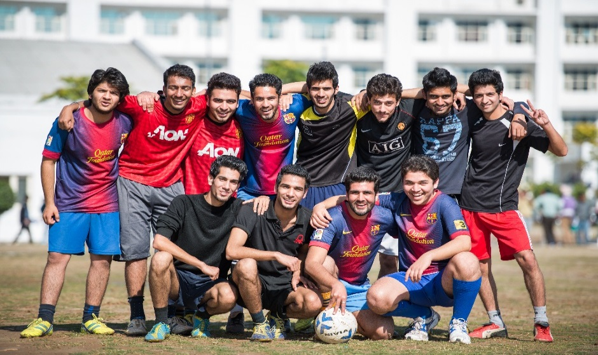

DEPARTMENT OF STUDENT WELFARE
Student Feedback and Grievance
Open House Sessions
Sports
Clubs and Committees
Organizing Festivals
Student care Centers
students and management Interface
www.cuchd.in
Campus: Gharuan, Mohali

Slide 71
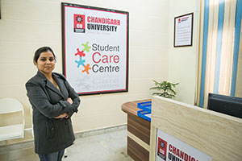
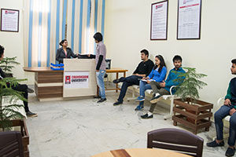
STUDENT CARE CENTERS
A Student Care Center has been established in each block wherein the student care executives provide the solution within 24 hours and have to follow up with the students as well, Thus providing a “Single Spot Solution” for all student problems/services.
www.cuchd.in
Campus: Gharuan, Mohali

Slide 72
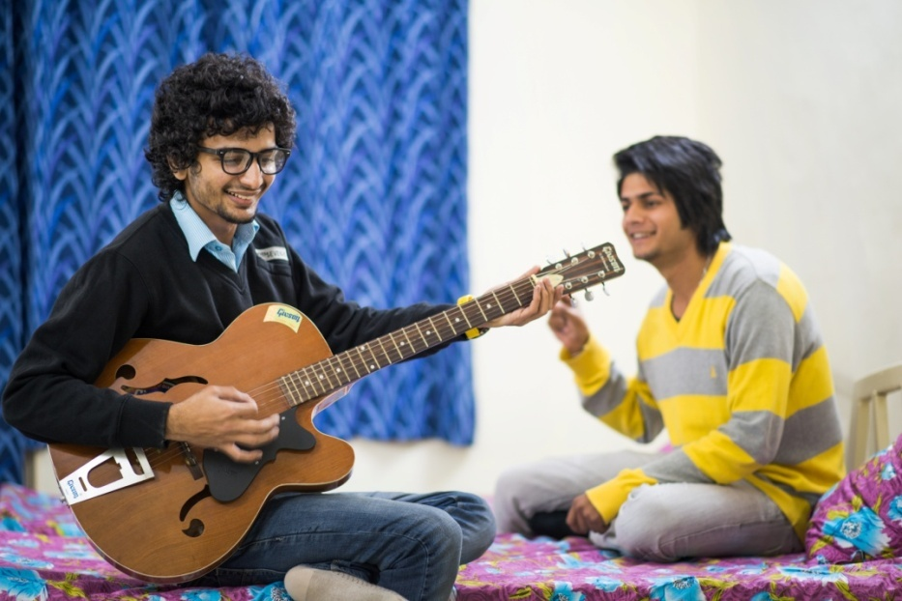

HOSTELS
Boys Hostel
5000 students
Girls Hostel
2000 students
www.cuchd.in
Campus: Gharuan, Mohali

Slide 73
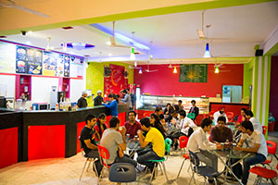
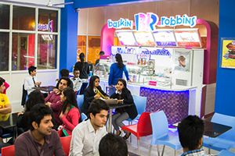


FOOD COURTS (In Campus)
SUBWAY
CAFE COFFEE DAY
GOLI – VADA PAO
BASKIN ROBBINS
BAKES & DESSERTS
JUJUS CAFÉ
VERKA
SINGH BAKERS
JUICE BAR
LORDS FOOD COURT
www.cuchd.in
Campus: Gharuan, Mohali

Slide 74
CAREER DEVELOPMENT SERVICES
Employment through Campus Placement Drives
Counseling & Support for Higher Studies
Support for Preparation for Civil & Armed Services
Entrepreneurship through “Idea to Enterprise”
www.cuchd.in
Campus: Gharuan, Mohali

Slide 75
TRAINING FOR PLACEMENTS
360° Program
Comm. Skills
Aptitude Test
Verbal Ability
Soft Skills
IT based Technical Skills
Core Technical Skills
www.cuchd.in
Campus: Gharuan, Mohali

Slide 76
COMPREHENSIVE TRAINING SOLUTION
Communication Skills
Business Communication
Life Skills
Self and interpersonal skill
Telephone Etiquettes
Comprehension
Email Etiquettes
Essay/ Passage Writing
Change Management
Goal Setting
Time Management
Team work
Stress Management
www.cuchd.in
Campus: Gharuan, Mohali

Slide 77
COMPREHENSIVE TRAINING SOLUTION
Soft Skills
Resume building
Aptitude skills
Fundamental Mathematics
Extempore speeches
Case presentation and Analysis
Group Discussions
Technical/ Personal Interviews
Quantitative Aptitude
Logical Reasoning
Verbal aptitude
Puzzles and Picture analysis
www.cuchd.in
Campus: Gharuan, Mohali

Slide 78
COMPREHENSIVE TRAINING SOLUTION
Technical IT Based
Java, .Net
Technical Core
Quiz in each subject
Engineering practices
OOP Concepts
Industrial experts
Projects at each level
Data-structures and Algorithms
www.cuchd.in
Campus: Gharuan, Mohali

Slide 79
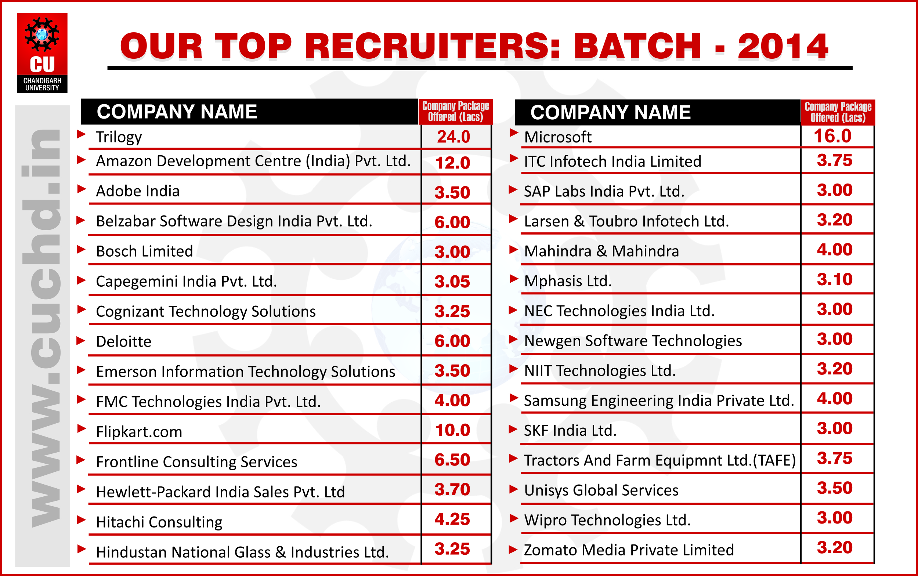
PLACEMENTS
www.cuchd.in
Campus: Gharuan, Mohali

Slide 80

PLACEMENTS
www.cuchd.in
Campus: Gharuan, Mohali

Slide 81
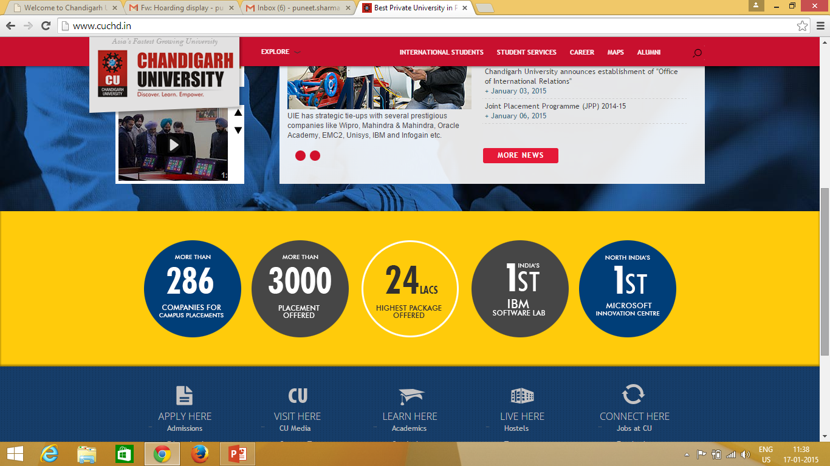
PLACEMENTS
Some Facts for Batch 2014
www.cuchd.in
Campus: Gharuan, Mohali

Slide 82

ENTREPRENEURSHIP DEVELOPMENT CELL
Regular Interactive meetings arranged with students to mentor them to take on entrepreneurship.
Incubator being setup with financial support of about Rs. 4.5 Million from DST Govt. of India to encourage students to start their new ventures at Campus for a limited initial period.
Students already running E-Governance Cell, Travel Agency , Marketing Research Agency.
CU has collaborated with National Small Industries Corporation Ltd. (NSIC), a Government of India Enterprise, in order to further promote Entrepreneurship in the students.
www.cuchd.in
Campus: Gharuan, Mohali

Slide 83

STUDENT ACHIEVEMENTS
www.cuchd.in
Campus: Gharuan, Mohali

Slide 84
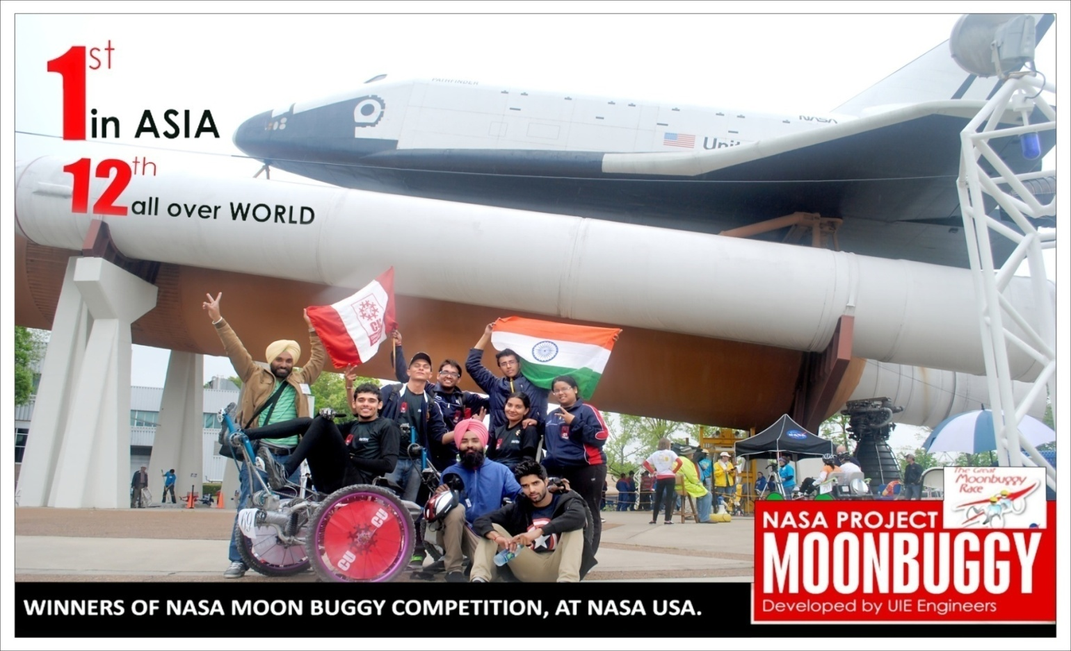
INTERNATIONAL ACHIEVEMENTS
MOONBUGGY
www.cuchd.in
Campus: Gharuan, Mohali

Slide 85
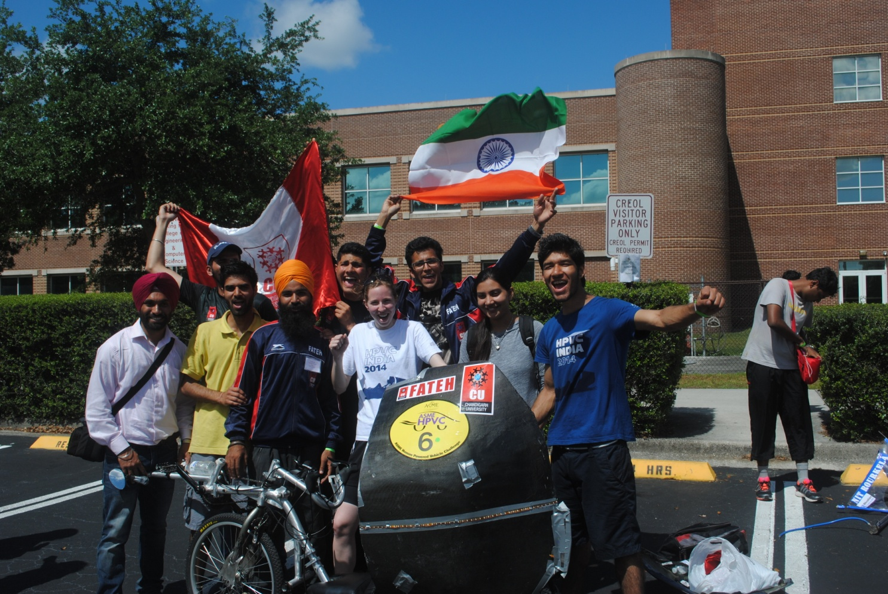
INTERNATIONAL ACHIEVEMENTS
Human Powered Vehicle (HPVC)
CU Got
1st Position in Asia
8th All over World
Competition Organized by American Society American Society of Mechanical Engineering in Colorado, USA
www.cuchd.in
Campus: Gharuan, Mohali

Slide 86
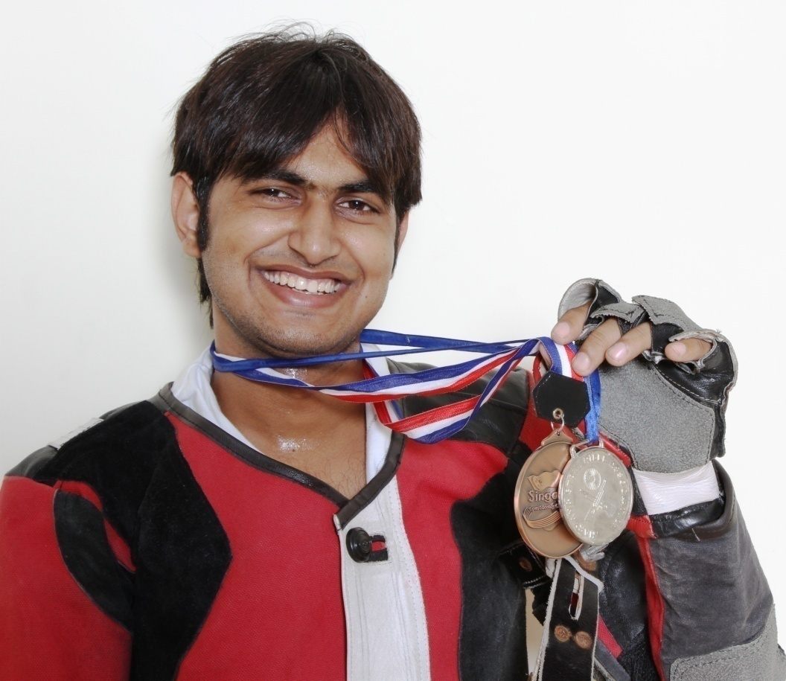
INTERNATIONAL SHOOTING COMPETITION
Mr. Sandeep Sharma, Student of UIAM won a number of Medals in International Shooting Competition held at Singapore
www.cuchd.in
Campus: Gharuan, Mohali

Slide 87
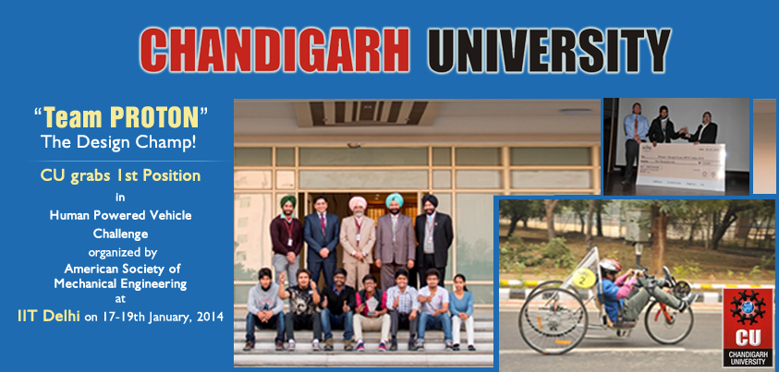
NATIONAL ACHIEVEMENT
Human Powered Vehicle (HPVC)
www.cuchd.in
Campus: Gharuan, Mohali

Slide 88
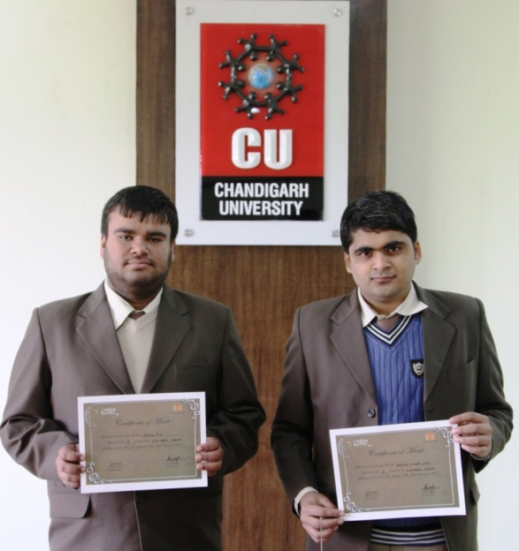
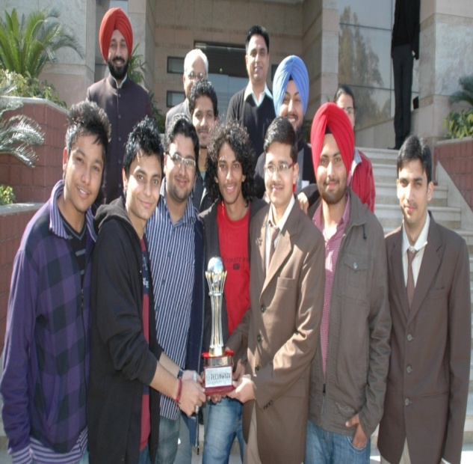
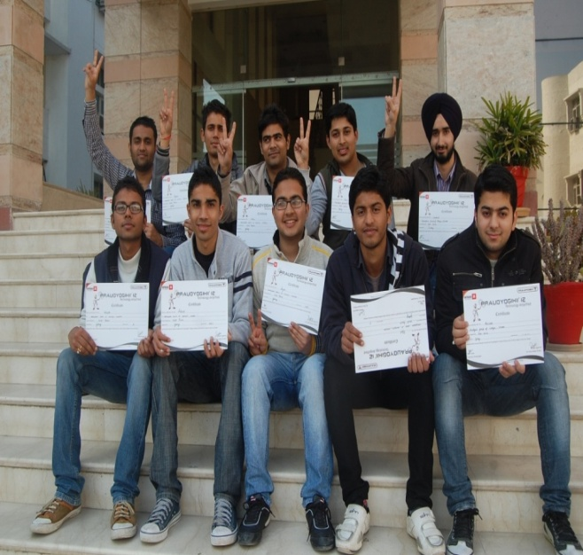
NATIONAL LEVEL ACCOLADES
CU Team emerged as winners in various other events held at IIT’s , Kanpur, NIT-Jalandhar, NIT-Kurukshetra, Thapar University, IIT Mumbai in events like Robowar, Robosoccer, Dash 4 Cash Race, Mud Rally and many more….
www.cuchd.in
Campus: Gharuan, Mohali

Slide 89
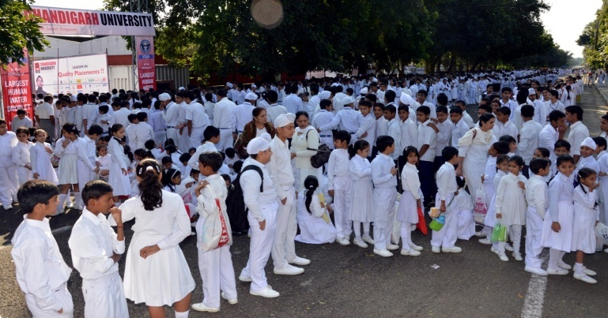
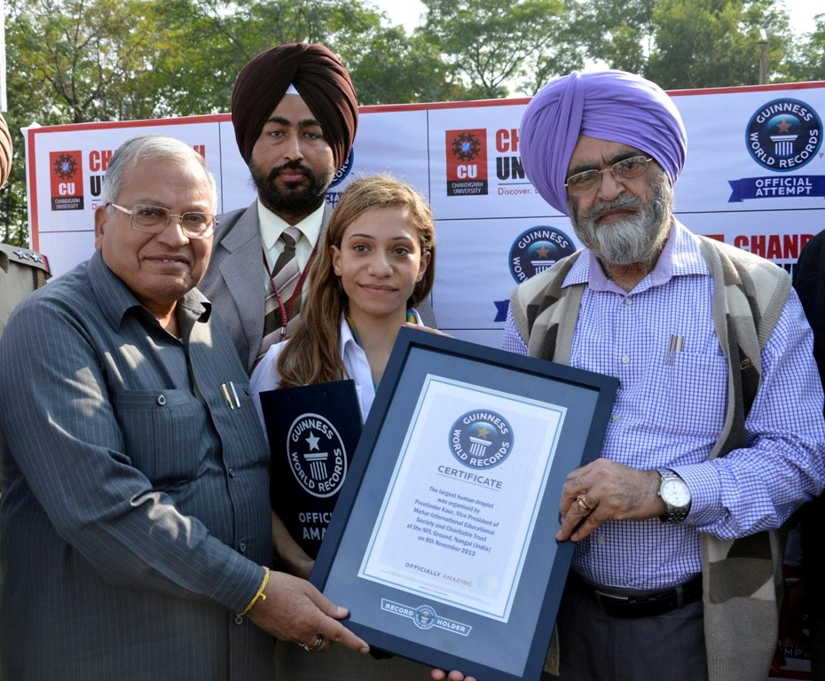
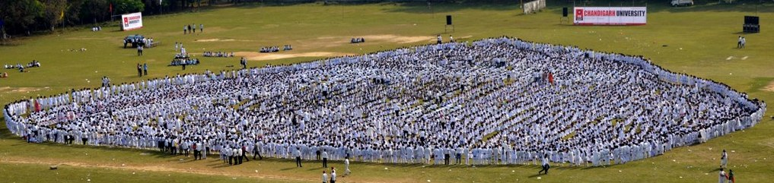
GUINNESS WORLD RECORD
World’s Largest Human Water Droplet
Ms. Fortuna Burke , Official from Guinness and Sh. M.M Mittal, Hon’ble Minister, Presenting Guinness Certificate to Prof. (Dr.) R.S. Bawa, Vice Chancellor, Chandigarh University
www.cuchd.in
Campus: Gharuan, Mohali

Slide 90
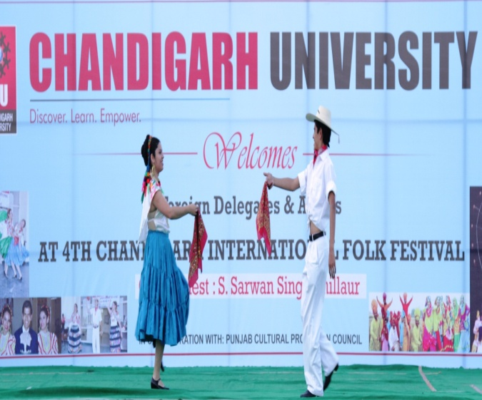
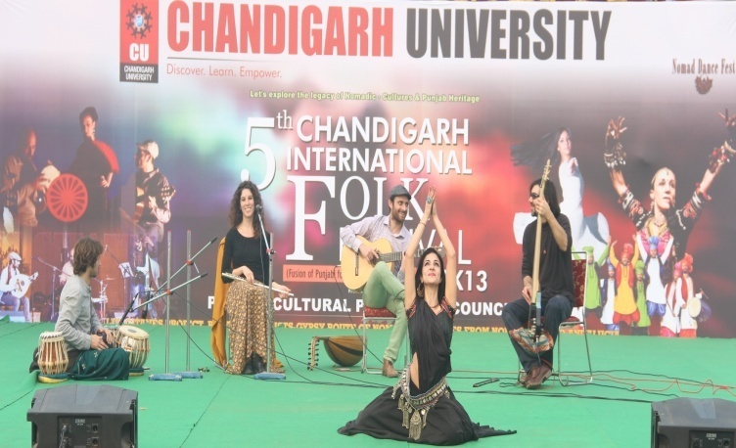
INTERNATIONAL FOLK FESTIVAL
Mexican & Italian Artist Performing at International Folk Festival
* This year Artist from Czech Republic, Spain will be visiting
www.cuchd.in
Campus: Gharuan, Mohali

Slide 91

INSTITUTIONAL SOCIAL RESPONSIBILITY
SCHOLARSHIP TO SC/ST & OTHERS
NEIGHBORHOOD SCHOOL DEVELOPMENT PROGRAM
PROJECT ‘PURE’
CAREER COUNSELING IN RURAL SCHOOLS
PROTECTION OF ENVIRONMENT
MEDICAL CHECKUP & BLOOD DONATION CAMP
INSPIRE CAMP
PROJECT UDAAN
RURAL SPORTS
www.cuchd.in
Campus: Gharuan, Mohali

Slide 92
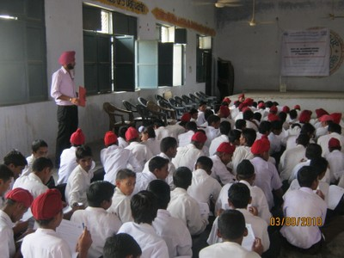
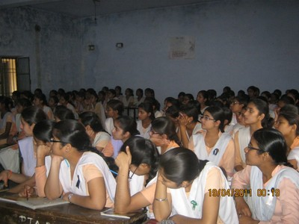
INSTITUTIONAL SOCIAL RESPONSIBILITY
NEIGHBORHOOD SCHOOL DEVELOPMENT PROGRAM
Chandigarh University has adopted the following schools :-
GOVERNMENT GIRLS SENIOR SCHOOL, GHARUAN
GOVERNMENT BOYS SENIOR SCHOOL, GHARUAN
Facilities provided:
Teachers for main subjects Economics and Communication skills
Fee concessions for meritorious students
Support for Infrastructure development and facilities
www.cuchd.in
Campus: Gharuan, Mohali

Slide 93
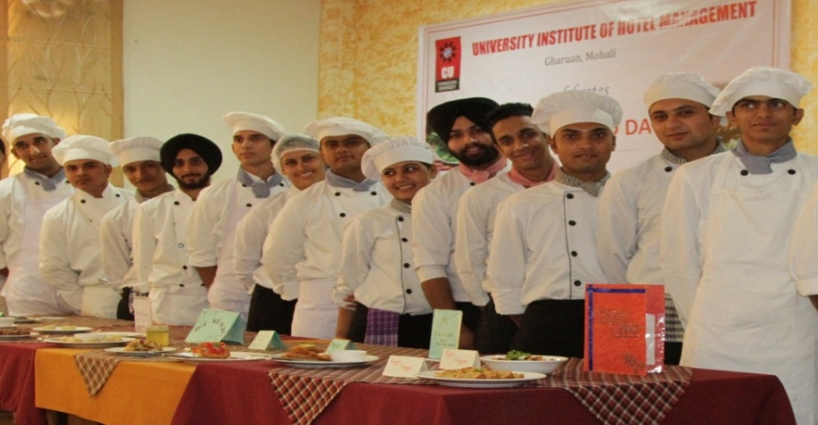
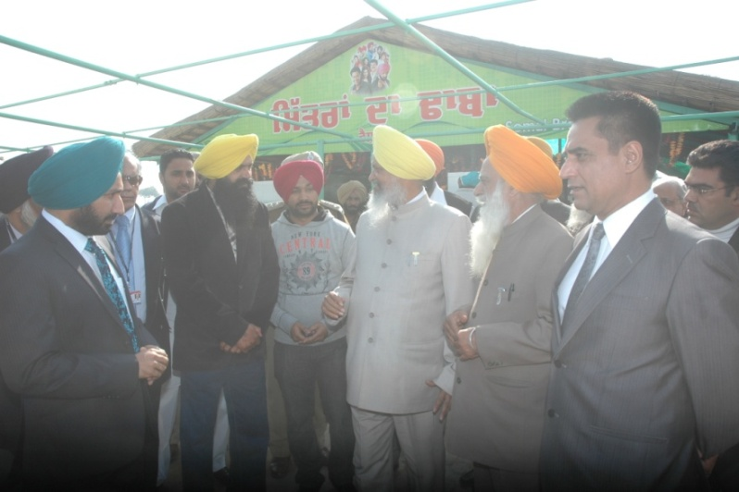
INSTITUTIONAL SOCIAL RESPONSIBILITY
PROJECT FOR UPGRADATION OF ROADSIDE EATERIES (PURE)
AIMS AND OBJECTIVES
Improve standards of the eateries.
Better hygiene and cleanliness
Training of staff
Kitchen planning
Better waste disposal
Assist owners getting the food license.
www.cuchd.in
Campus: Gharuan, Mohali

Slide 94
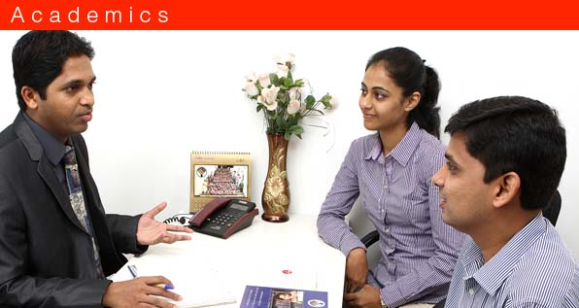
INSTITUTIONAL SOCIAL RESPONSIBILITY
CAREER COUNSELLING
Provide updated knowledge about career options to about hundred thousand students of +1 and +2 of North region
Help Students in identifying strengths/ weaknesses to facilitate right career choice.
Provide the nation, capable, willing & motivated professionals
Promote & participate in Govt. schemes.
www.cuchd.in
Campus: Gharuan, Mohali

Slide 95
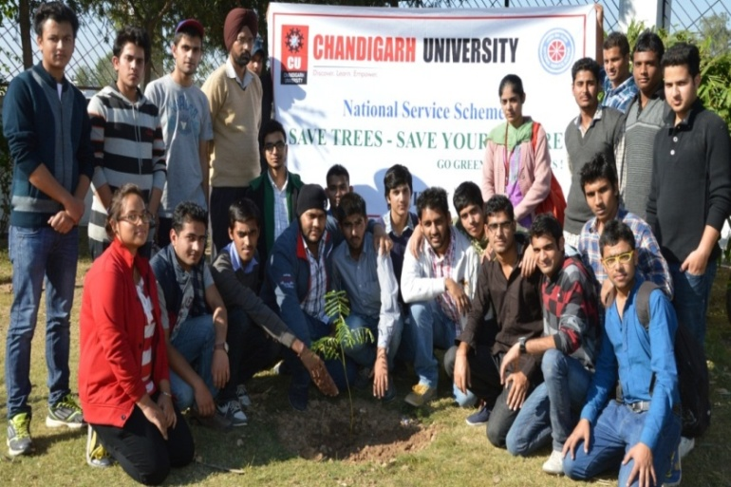
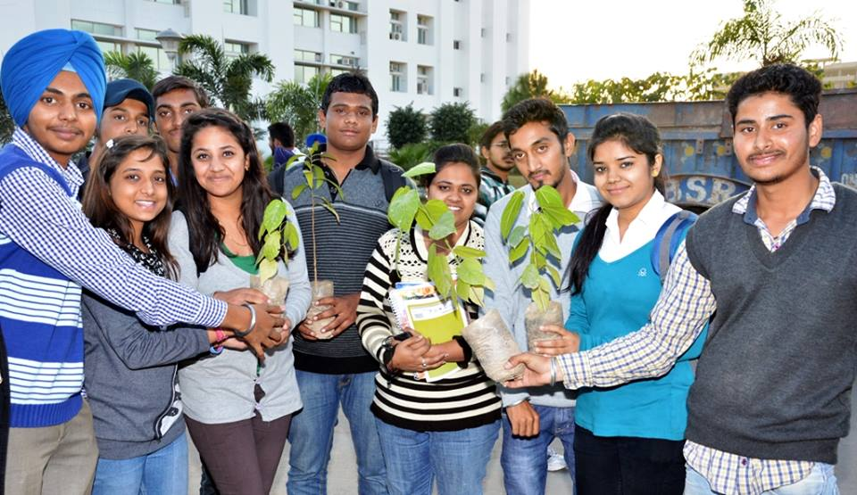
INSTITUTIONAL SOCIAL RESPONSIBILITY
PROTECTION OF ENVIRONMENT
Chandigarh University is maintaining a green belt of 2 KMS (1kms either side of the university)
New trees have been planted and the old trees has been preserve by the university
Jyot-e-Haryaval (Mission green)
Project Jyot-e-Haryaval is an initiative of Chandigarh University to heal the planet, where every student contributes something that aggregates into a colossal protection for life on the planet. It aims to increase the green cover of the State of Punjab. The project is bringing respite to the ecology without imposing any financial burden on the state.
www.cuchd.in
Campus: Gharuan, Mohali

Slide 96
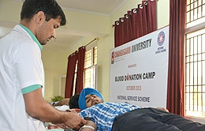
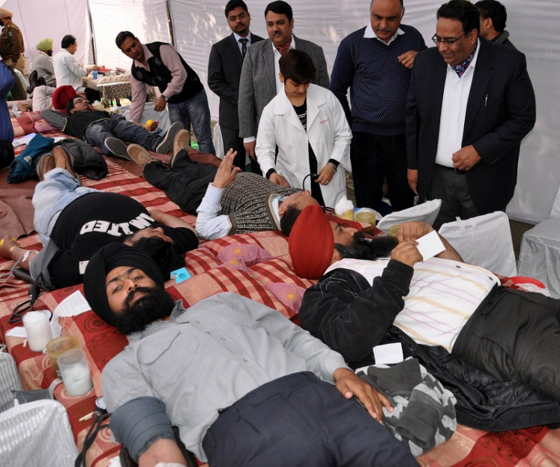
INSTITUTIONAL SOCIAL RESPONSIBILITY
Medical Checkup & Blood Donation Camp
Camps organized in collaboration with PGI.
4 camps organized in last one and half year
1400 units donated by students
More camps planned in coming semesters
www.cuchd.in
Campus: Gharuan, Mohali

Slide 97
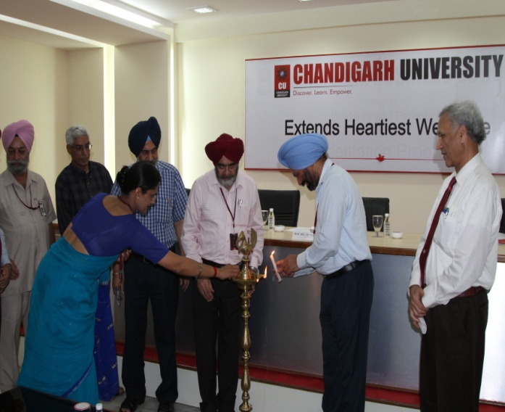
INSTITUTIONAL SOCIAL RESPONSIBILITY
INSPIRE 2014
Chandigarh University has organized the first DST sponsored INSPIRE camp to motivate the students of class XI and XII to chose the basic sciences as an career option.
Eminent scientists have visited the camp and motivated the students to join the field of science and innovation.
Dr Arvinder, Scientist, Quantum Physics, IISER, Mohali
Dr G S Sodhi, Scientist, Forensic Sciences, Delhi
Dr Neeraj Khare, Dept. of Physics IIT, Delhi
Dr Pardeep Ramcharla, Scientist, Earth Sciences, IIIT, Hydrabaad
Dr M S Chauhan, NDRI, Karnal
Dr U K Sharma, Scientist, D, Dept. of Science and Technology, New Delhi
www.cuchd.in
Campus: Gharuan, Mohali

Slide 98

INSTITUTIONAL SOCIAL RESPONSIBILITY
PROJECT UDAAN FOR J&K STUDENTS
Free 90 days training for technical & Soft Skills Development.
Transport expense from J & K to CU, SAS Nagar.
Free Boarding and Lodging.
Stipend Rs.2500 per month per trainee.
Free Medical facilities for minor ailments.
Free Study material.
Initiative of National Skills Development Corporation (NSDC)
Aims at bringing change in youth of J&K.
Target 40,000 youths in 5 years.
Program at Chandigarh University being financed by ONGC
Training of three batches conducted till date (Total 87 students)
www.cuchd.in
Campus: Gharuan, Mohali

Slide 99
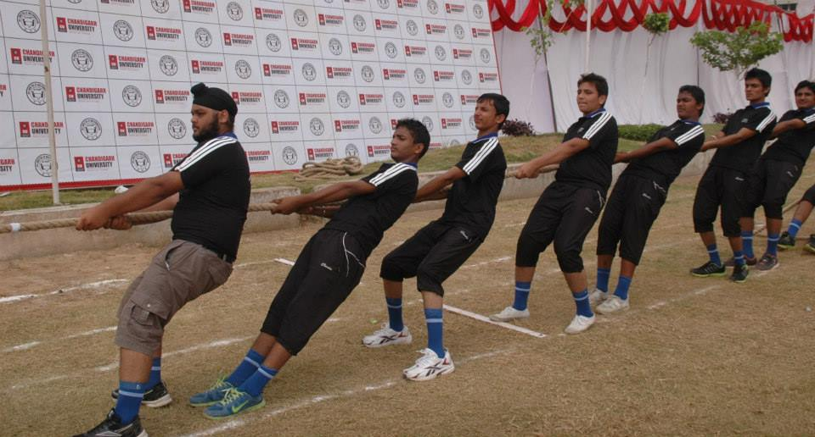
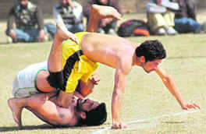
INSTITUTIONAL SOCIAL RESPONSIBILITY
Promoting Sports in Rural Areas
Propounds “sound mind in sound body”.
Aims to uplift youth from drug abuse.
Reduce rate of obesity.
Providing sports facilities within the campus.
Participating and financing Rural sports Tournaments in Gharuan.
www.cuchd.in
Campus: Gharuan, Mohali

Slide 100
INSTITUTIONAL SOCIAL RESPONSIBILITY
Promoting Sports in Rural Areas
Propounds “sound mind in sound body”.
Aims to uplift youth from drug abuse.
Reduce rate of obesity.
Providing sports facilities within the campus.
Participating and financing Rural sports Tournaments in Gharuan.
www.cuchd.in
Campus: Gharuan, Mohali

Slide 101
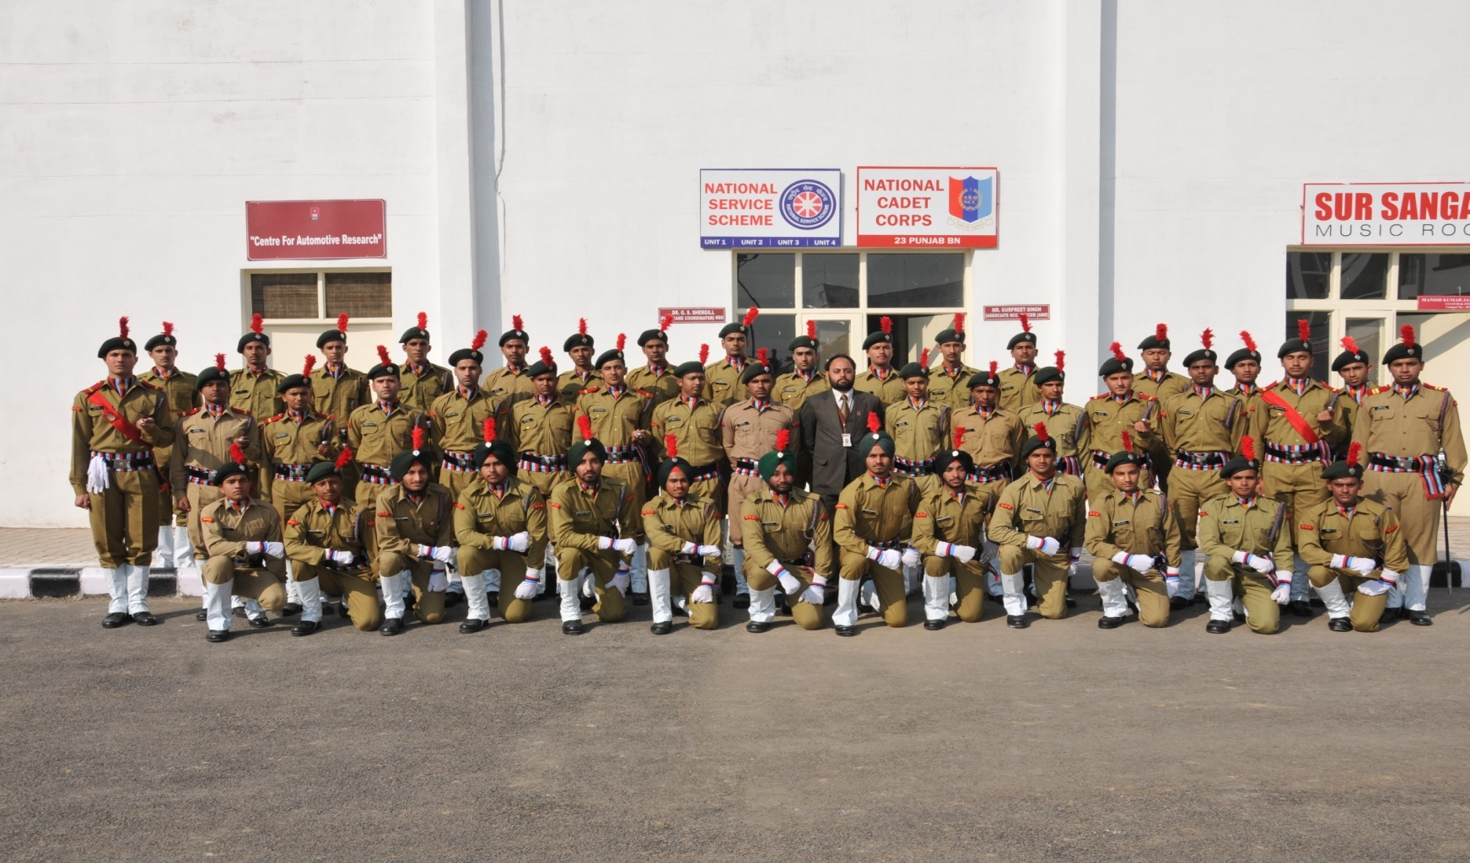
CU-NATIONAL CADET CORPS (NCC)
Full Fledge Company of 160 Cadets
www.cuchd.in
Campus: Gharuan, Mohali

Slide 102
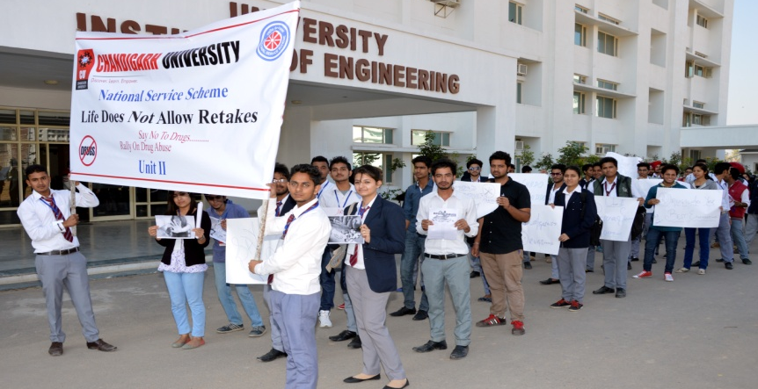
CU-NATIONAL SERVICE SCHEME (NSS)
Four Units of 400 Volunteers
www.cuchd.in
Campus: Gharuan, Mohali

Slide 103
INDUSTRY ACADEMIA INTERFACE
CORPORATE ADVISORY BOARD
INDUSTRY EXPERTS IN BOARD OF STUDIES
INDUSTRIAL COLLABORATIONS
www.cuchd.in
Campus: Gharuan, Mohali

Slide 104

CORPORATE ADVISORY BOARD
www.cuchd.in
Campus: Gharuan, Mohali

Slide 105
OBJECTIVE
In order to peruse and fulfill vision and mission of the University, Chandigarh university has established Corporate Advisory Board (CAB).
The CAB comprises the business leaders, top Entrepreneurs and senior level executives from blue chip Corporates of India.
Chandigarh University Corporate Advisory Board (CUCAB) is positioned to serve as crucial interface between the University and the Corporate World.
CUCAB is expected to provide inputs and advice on the strategic options, future directions and path breaking initiatives to help the University creating new benchmarks and achieve all round excellence.
The Board is also expected to have the University to make its presence felt, broaden its activities and enhance its status in the world of professional education.
www.cuchd.in
Campus: Gharuan, Mohali

Slide 106
ROLE OF CORPORATE ADVISORY BOARD
To guide the University in fulfilling the Vision & Mission.
To guide the University in drawing a Roadmap for future growth and Expansion.
To advise the University about the strategic steps to ensure Quality & Excellence in its activities and enhance its stature & visibility.
To help the University in identifying cutting edge courses and programs that may be introduced in the University.
To advise the University about measures to improve quality of the Faculty.
To advise the University in foregoing suitable collaboration with industry for undertaking sponsored research projects.
www.cuchd.in
Campus: Gharuan, Mohali

Slide 107

1st MEETING OF CORPORATE ADVISORY BOARD
www.cuchd.in
Campus: Gharuan, Mohali

Slide 108

OUTCOME UNDER FUNCTIONAL HEADS
www.cuchd.in
Campus: Gharuan, Mohali

Slide 109
CORPORATE ADVISORY BOARD
Sr.No. | Company Name | Corporate Member | Designation
1 | Microsoft Corp. India | Mr. Joseph Landes | General Manager
2 | Microsoft Corp. India | Mr. Yogesh Kochhar | Director Public Policy
3 | Google India | Ms Shetambhri Nath | Head-HR
4 | IBM India | Mr. D.P. Singh | Vice President - Human Resources
5 | VE Commercial Vehicles | Mr. Amanppreet Singh Bhatia | Sr. Vice President-HR
6 | Wipro Technologies | Mr. Viswanathan Subramanian | Vice-President
7 | Reliance Industries . | Mr. Souvik Chakraborty | Chief Talent Officer
8 | Samsung Engg. India | Mr. Vinay Kaushik | Vice President - Human Resources
9 | Jindal Steel & Power | Mr. Rajeev Bhadauria | Director Group HR
10 | TAFE (Tractors & Farm Equipment | Mr. Muthu Thanu | Group CHRO
www.cuchd.in
Campus: Gharuan, Mohali

Slide 110
CORPORATE ADVISORY BOARD
Sr.No. | Company Name | Corporate Member | Designation
11 | SAP Labs | Mr Dinu Nanjappa | Head-Talent Aquisition
12 | HCL Comnet Ltd. | Mr. Puneet Kumar Pandey | Director HR
13 | NEC Systems | Ms. Debyani Sinha | HR Head
14 | Grail Research | Mr. Vivek Neb | Vice President- Research
15 | Steria India | Ms.Natasha Singh | Sr. VP HR
16 | Polaris Financial | Mr. Vinodh Chelambathodi | Global Head HR
17 | Hindustan Zinc Vedanta Group | Mr. Sunil Duggal | Chief Operating Officer
18 | Jabong.Com/AquaBrim Pvt. Ltd. | Mr. Praveen Sinha | Co-founder and MD
19 | Persistent Systems Ltd. | Mr. Sameer Bendre | Chief People Officer
20 | MIRC Electronics (Onida) | Dr. Yasho V. Verma | CEO
www.cuchd.in
Campus: Gharuan, Mohali

Slide 111
CORPORATE ADVISORY BOARD
Sr.No. | Company Name | Corporate Member | Designation
21 | Thought Works Technologies(India) Pvt. Ltd. | Mr Nitin Dhall | General Manager
22 | Sapient Consulting Ltd. | Mr. Anand Bhaskar | Vice President – People Success
23 | CK Birla Group | Mr. Michael Joseph | Group Talent Acquisition Head
24 | Atos Origin India | Mr. Paneesh Rao | Sr. Vice President- HR
25 | L&T Infotech | Mr. Prashant Karandikar | Head - Strategic Resourcing
26 | Dassault Systems India | Mr. Rohit Kapoor | Geo HR Director
27 | Quark India | Mr. Sofi Zahoor | Sr. Director HR
28 | Adventz Group | Mr. PK Gandhi | Group President-HR
29 | TCG Hamilton Group | Mr Rajiv Gupta | President & CEO
30 | Tech Mahindra Ltd. | Ms. Mangala V | Associate Director (RMG)
www.cuchd.in
Campus: Gharuan, Mohali

Slide 112
CORPORATE ADVISORY BOARD
Sr.No. | Company Name | Corporate Member | Designation
31 | Oracle Financial | Mr. Madhukar Kapoor | VP , HR
32 | Bajaj Electricals Ltd. | Mr. Atul Sharma | President - Human Resources and Administration
33 | Employment Access | Mr. Souvik Chakraborty | Ex-Reliance Industries Ltd, CTO
34 | Hindustan Zinc Ltd. (HZL) Vedanta Group | Mr. Sunil Duggal | Chief Operating Officer
35 | Zensar Technologies Ltd. | Mr. Ganesh Natarajan | Vice Chairman and CEO
36 | Linkedin Technology Information Pvt Ltd. | Mr. Punith Suvarna | Head - Talent Acquisition, India
37 | ABB India Limited | Mr. Dileep Mypalli | Head- HR Center, India & Regional Talent Acquisition Manager-IMEA
38 | Tata Chemicals Ltd. | Mr. R. Nanda | VP & CHRO
39 | DELL Services | Mr. Adarsh Naik | India Lead – University Relations
40 | iGate Patni Computer Systems Ltd. | Mr. Srinivas Kandula | EVP & Global Head HR
www.cuchd.in
Campus: Gharuan, Mohali

Slide 113
CORPORATE ADVISORY BOARD
Sr.No. | Company Name | Corporate Member | Designation
41 | FMC Technologies India Pvt Ltd. | Mr. Shiva Singeetham | Global Engineering Resources Manager
42 | Vedanta Group | Mr. Rajesh Padmanabhan | President, CHRO
43 | Apollo Tyres Ltd. | Mr. Tapan Mitra | Chief - Human Resources
44 | Maruti Suzuki India Ltd. | Mr. S.Y. Siddiqui | Chief Operating Officer-Administration
45 | Facebook India | Mr. Mayank Tivary | Lead Recruiter
46 | Ericsson India Pvt. Ltd. | Mr. Sameer Khanna | VP and Head - Human Resources
47 | Zomato.Com | Ms. Radhika Rai | VP Recruitment
48 | Computer Sciences Corporation India (P) Ltd. | Mr. Sreekanth K Arimanithaya | Vice President, Human Resources
49 | Infogain India Pvt Ltd. | Maj Gen S. K. Nanda, AVSM | Chairman
50 | Petronet LNG Ltd. | Dr. AK Balyan | MD & CEO
www.cuchd.in
Campus: Gharuan, Mohali

Slide 114
INDUSTRY EXPERTS IN BOARD OF STUDIES
Board of Studies designs and defines the syllabus and curriculum of the course.
Every Board of studies has at least 2 experts from the industry.
They provide industrial inputs to develop dynamic curriculum.
Representatives of IBM, Infosys, Quark, L&T, Samsung India, TAFE Mahindra & Mahindra, CSIO, JREW Engineering and many more are members of BOS.
www.cuchd.in
Campus: Gharuan, Mohali

Slide 115

INDUSTRY COLLABORATIONS
Microsoft Global Technical Support Center
Microsoft Innovation Centre
IBM Software Lab for Emerging Technology
Tech Mahindra T-School
Wipro Mission10X Technology Learning Centre
IBM Rational SEED Lab
Oracle Academy
www.cuchd.in
Campus: Gharuan, Mohali

Slide 116
INDUSTRY COLLABORATIONS
MOU with ITC Infotech
MOU with Infogain
MOU with Holiday Inn(Inter Continental Group)
Mentor Graphics University Scheme
MSC Center of Excellence
EMC Academic Alliance
Unisys Academic Collaboration
Mahindra & Mahindra T-School
www.cuchd.in
Campus: Gharuan, Mohali

Slide 117

INDIA GLOBAL TECHNICAL SUPPORT CENTER (IGTSC)
Under IGTSC program of Microsoft, only 3 Universities in India have such centers.
Microsoft will adopt and mentor the students from 1st year itself.
Opportunity to Study latest & futuristic technologies.
Master Trainers from Microsoft.
Students will be hired by Microsoft upon successful completion.
Stipend based internship program
www.cuchd.in
Campus: Gharuan, Mohali

Slide 118

MICROSOFT INNOVATION CENTER
Only 97 centers in the world.
Access to Microsoft White Pages
Connections with MIC’s across world
North India’s Only Center
Access to latest Microsoft Software
Trainings and Competitions
MR. JOSEPH LANDES, GM, MICROSOFT INAUGURATING NORTH INDIA’S ONLY MICROSOFT INNOVATION CENTRE AT CHANDIGARH UNIVERSITY
www.cuchd.in
Campus: Gharuan, Mohali

Slide 119

IBM LAB FOR EMERGING TECHNOLOGIES
India’s First Software Lab offering Futuristic Technologies
www.cuchd.in
Campus: Gharuan, Mohali

Slide 120

WIPRO MISSION 10X TECHNOLOGY LEARNING CENTER
Special UTLP kits given by Wipro for project.
Projects are monitored regularly by Wipro officials.
Caters to the need of 2020 on Robotics, Automation, Medical equipment's, mobility, gadget programming.
Technical guidance is given by industry technocrats.
MR. HEMCHANDRA BHATT, HEAD-UTLP INAUGURATING NORTH INDIA’S ONLY WIPRO RESEARCH LAB
www.cuchd.in
Campus: Gharuan, Mohali

Slide 121

MOU WITH INFOGAIN
MR. YELWAL SRINIVAS, GM CAMPUS CELL, INFOGAIN AND DR B. S. SOHI, PRO-VC CU
EXCHANGING MOU FILES
www.cuchd.in
Campus: Gharuan, Mohali

Slide 122

ORACLE ACADEMY INAUGURATION
ORACLE ACADEMY BEING INAUGURATED BY MR B. PURSHARTH (IAS)
DIRECTOR- TECHNICAL EDUCATION, PUNJAB
www.cuchd.in
Campus: Gharuan, Mohali

Slide 123

TECH MAHINDRA T- SCHOOL
IMS Academy established under Tech Mahindra T- School
Only 2 such academies in India.
Special Training on Infrastructural Management Services.
Mentoring and Training by Tech Mahindra staff.
Job Opportunity in Tech Mahindra
EXCHANGE OF MOU BETWEEN PROF. (DR.) R.S.BAWA VICE-CHANCELLOR-CHANDIGARH UNIVERSITY AND SH. SRIKANT VASE SR VICE PRESIDENT-TECH-MAHINDRA
www.cuchd.in
Campus: Gharuan, Mohali

Slide 124

ITC INFOTECH TRAINING PROGRAM
ITC Infotech conducts campus placements and selects students.
The selected students undergo special training program during their studies.
Master trainers from ITC conduct special training on latest technologies.
Students become industry ready before joining the company.
MS. PADMINI GIRI, VP-HR WITH SELECTED STUDENTS
www.cuchd.in
Campus: Gharuan, Mohali

Slide 125

Thanks
Queries are welcome
www.cuchd.in
Campus: Gharuan, Mohali

